Slide 1


WORLD YOUTH DAY
summer updates and news
Paul Jarzembowski
United States Conference
of Catholic Bishops (USCCB)
WYDUSA.ORG
KRAKOW2016.COM

Slide 2

summer updates and news
Opening Prayer
Latest News & Updates
Safety and Security Notes
Home Stretch Resources
Additional Concerns or Questions
Looking Beyond World Youth Day
Closing Prayer

Slide 3
summer updates and news
What questions do you have?
What concerns still remain unanswered that we may be able to address in this webinar?

Slide 4
Opening Prayer
God our Father,
Be with us in our
pilgrim journey of faith
Give us the grace and courage
to step forward in faith and hope
on the road ahead.

Slide 5
Opening Prayer
Lord Jesus,
Open our eyes to see your face
in all those we encounter.
Open our ears to hear your voice
in those who are often ignored.
Open our hearts that we might be
faithful disciples of mercy and truth.

Slide 6
Opening Prayer
Holy Spirit,
Transform us. Empower us
to give of ourselves to the poor;
to welcome the lost;
to forgive those who hurt us;
to comfort those who suffer
and are marginalized.

Slide 7
Opening Prayer
Bless those who travel on mission from the
United Sates of America to Krakow
in Poland, Land of Divine Mercy, to join
the universal Church for World Youth Day.
Bless, too, those who celebrate stateside,
united in faith and joy.

Slide 8
Opening Prayer
Like the disciples who journeyed
up the mountain
to witness the Transfiguration,
May this experience be an encounter
that strengthens us for
our work in the world.

Slide 9
Opening Prayer
Through the intercession of Mary,
the Immaculate Conception,
patroness of our nation,
may we be worthy witnesses of our faith,
humble representatives of our country,
and inspired missionaries bringing peace,
hope, and mercy into our communities. Amen.

Slide 10


Slide 11
Latest News & Updates
Current registered USA pilgrim numbers
International English Language Center
USA Gathering: Wednesday, July 27, 5pm
USA Mass: Saturday, July 30, 9am
Additional USA Pilgrim Events in Krakow
Recently Released Papal Schedule

Slide 12
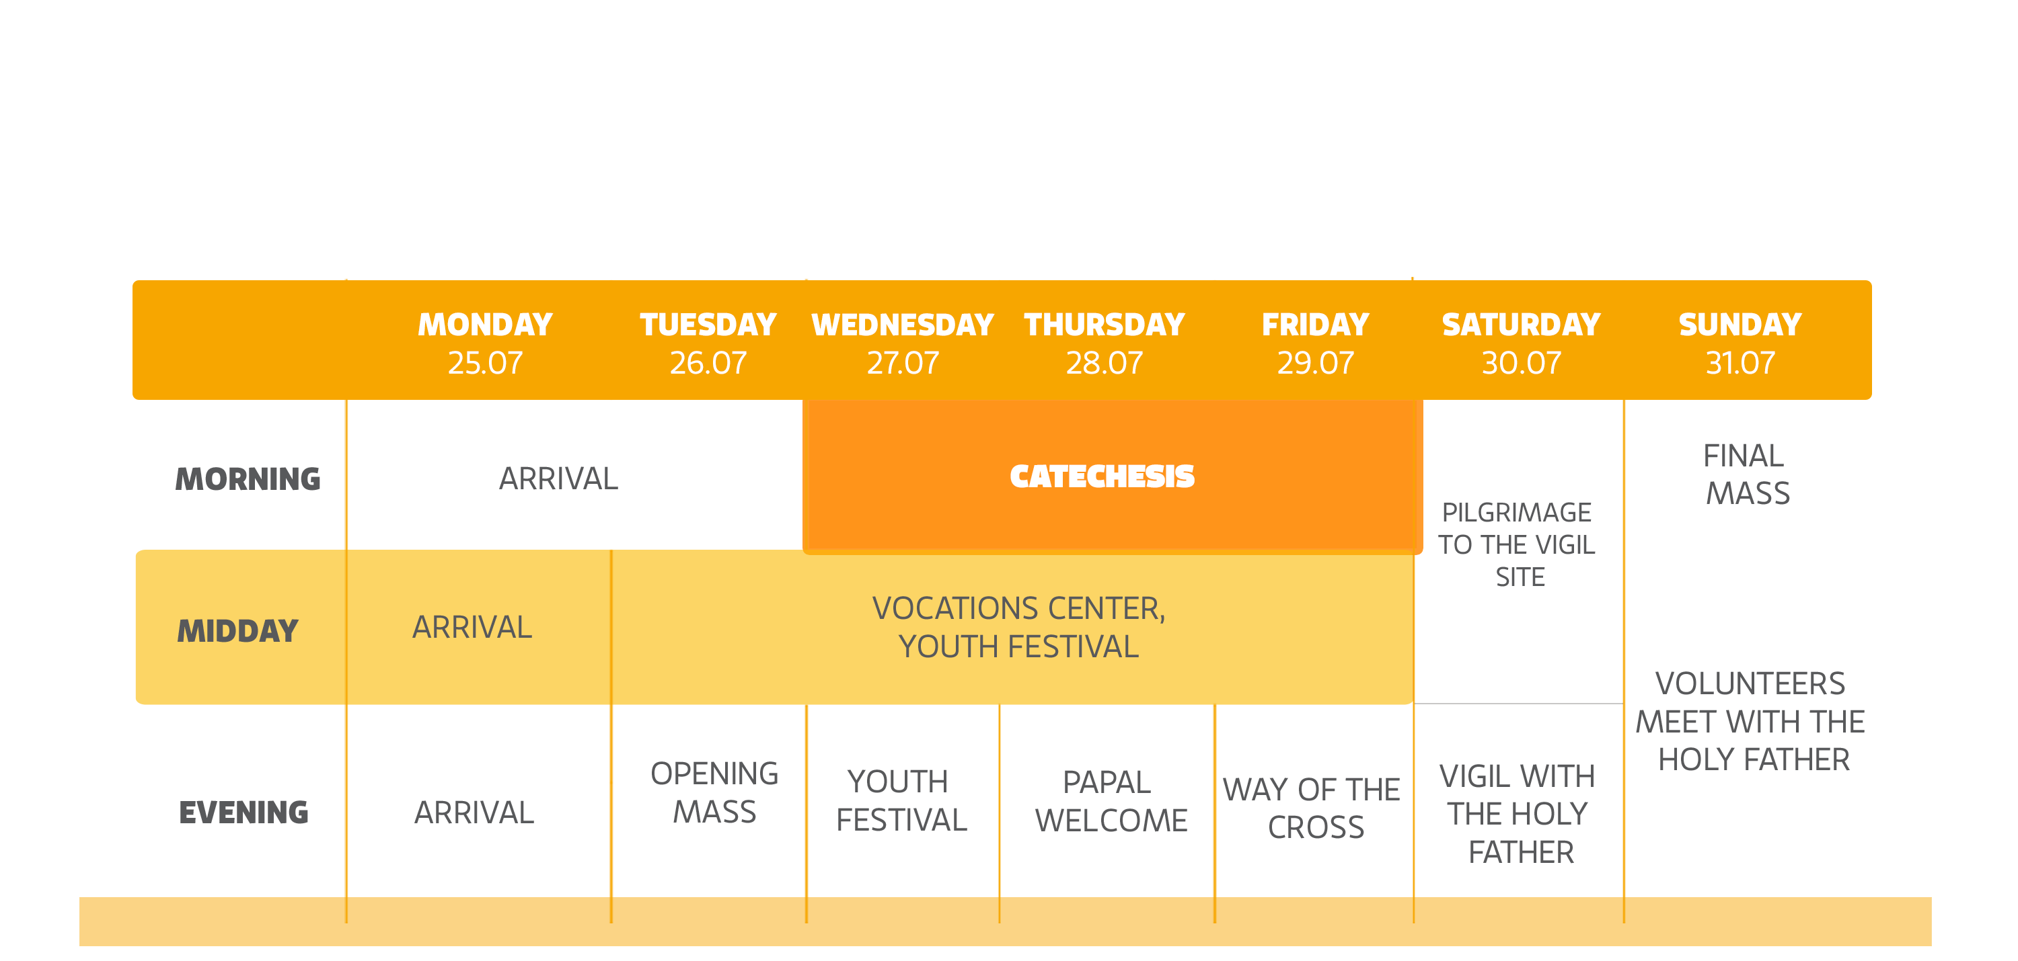
Latest News & Updates

Slide 13
Latest News & Updates
EVENTS AIMED AT OR LED BY USA PILGRIMS AND GROUPS
USA ANIMATION TEAMS @ CATECHESIS SITES;
USA CATECHIST BISHOPS @ CATECHESIS SITES
WYDUSA MASS 9:00 AM
FRASSATI USA PRAYER @ 1:00 PM THURS
YOUTH 2000 USA HOLY HR @ 4:00 PM THURS
WYDUSA GATHER
5:00 PM

Slide 14
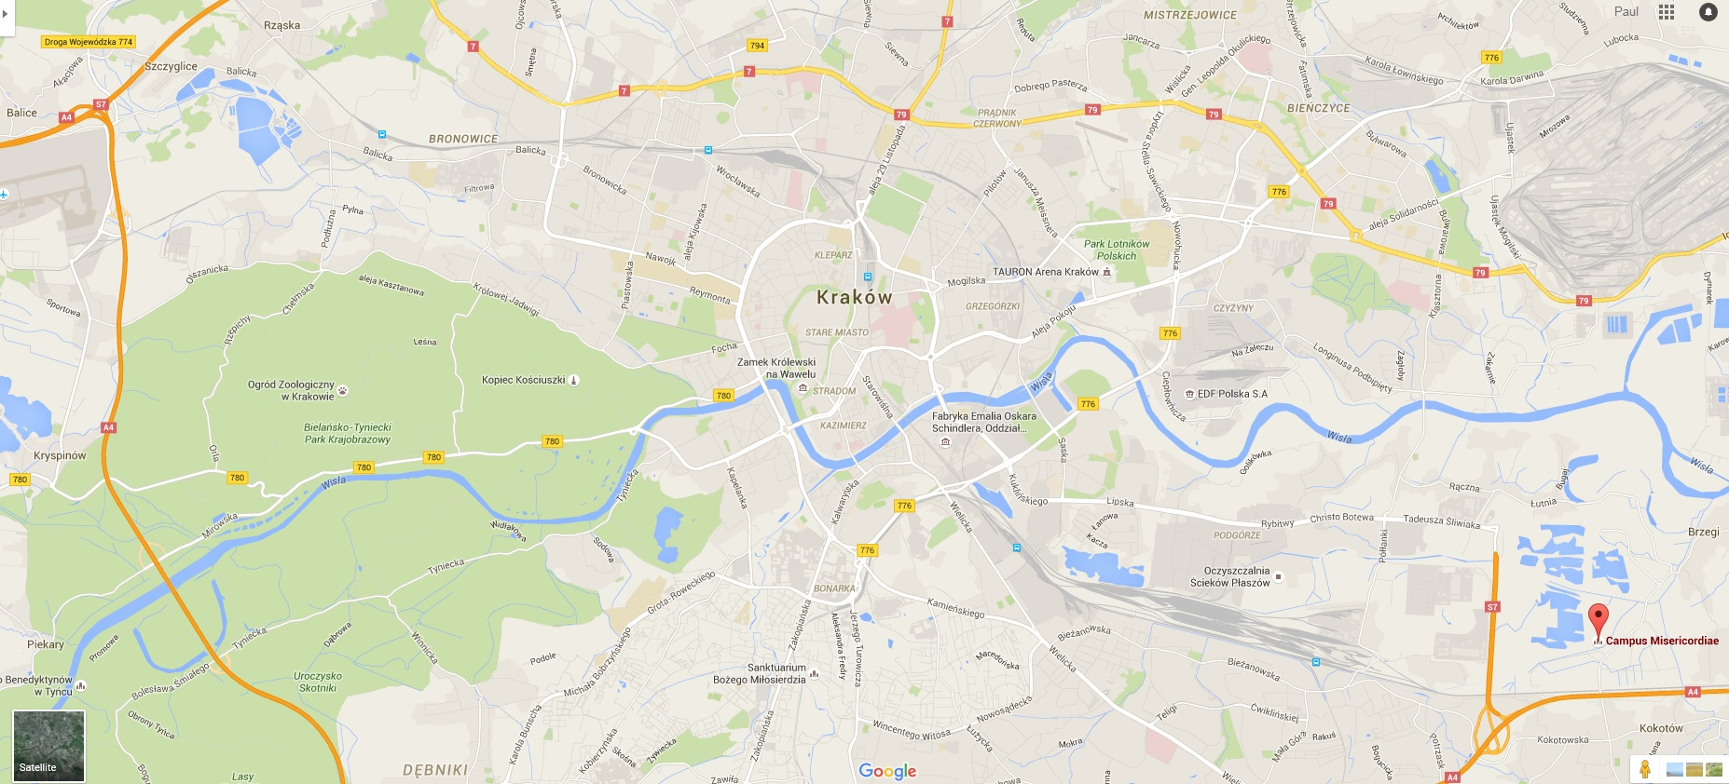
Latest News & Updates

Slide 16
Latest News & Updates
What questions do you have?
Besides security/safety issues and USCCB resources, what else would you like addressed?

Slide 17
Safety & Security Notes
U.S. State Department Travel Advisory
Krakow Consulate Website & Brochure
Visas and Passports; Border Security
WYDUSA Tips for Safety and Security;
Vigilance and Responsibility
WYD/Poland Safeguarding Measures

Slide 18
Safety & Security Notes
What questions do you have?
What additional safety and security concerns do you have that you would like addressed?

Slide 19
Home Stretch Resources
New WYDUSA Video Series for Pilgrims
WYD Pilgrim Journal; Mobile Application
Sending Forth: Prayer Services & Retreats
Stateside and Alumni Resources
Auschwitz and Ecumenical Supplements
Theme Song, Prayers, Patron Saints, & More

Slide 20

Resources: Video Series
available online
wyd2016.us
Introduction to WYD
Embracing God’s Mercy
Leading a WYD Pilgrimage
Being a WYD Pilgrim
Before Leaving for Krakow
Participating in WYD
Bringing WYD Home

Slide 21
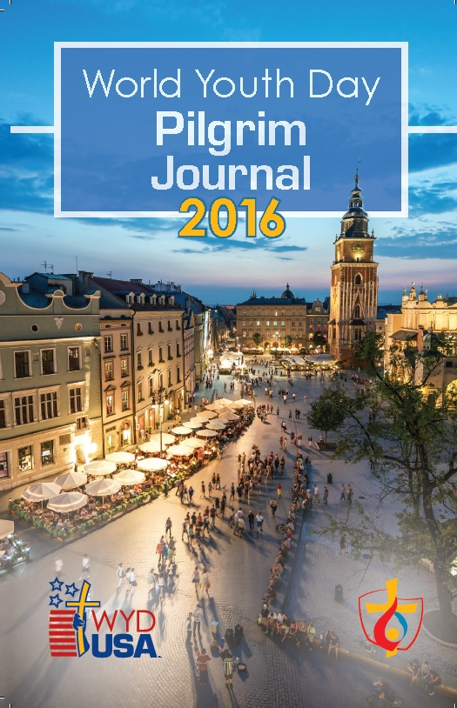

Resources: Journal & App
Journal available for purchase
http://store.usccb.org
Search “Pilgrim Journal” or “WYD Journal”
$14.00 each, or $10.00 with purchase of 10 or more
Pilgrimage Mobile Application
Collaboration with American Bible Society
Ideal for Krakow and stateside pilgrims
Free from iTunes/Android app stores

Slide 22

Resources: Sending Forth
Retreat Manual Resources
wyd2016.us
PDF or e-book versions available online
3-part (or 3 individual) retreat experience(s)
Pilgrim Blessing for World Youth Day
Prayer Experiences (on the road during WYD)
Book of Blessings, Ch. 8 & 9
Consult your local pastor or call your diocesan divine worship office.

Slide 23

Resources: Stateside & Alumni
Stateside Leader Guidebook
wyd2016.us
PDF or e-book, Spanish & English, versions
List of stateside celebrations: wydusa.org
Alumni Network & Guide
http://www.usccb.org/about/world-youth-day/wyd-alumni-network.cfm
New guide for planning a local WYD alumni reunion or special event

Slide 24
Resources: Supplements
Auschwitz Leaders Supplement
http://www.usccb.org/about/world-youth-day/upload/WYDUSA-Pilgrim-Leader-Guide-Auschwitz-Supplement-2016.pdf
Prayers for pilgrims visiting or discussing the Nazi death camps
Ecumenical Leaders Supplement
http://www.usccb.org/about/world-youth-day/upload/WYDUSA-Pilgrim-Leader-Guide-Ecumenical-Supplement-2016.pdf
Ideas and considerations for Christian ecumenical WYD engagement

Slide 25

Resources: Song & Prayers
Theme Song (English & Spanish)
http://www.usccb.org/about/world-youth-day/krakow-2016-official-song.cfm
Lyrics, sheet music, recordings, and more
Official WYDUSA Prayer
http://www.usccb.org/about/world-youth-day/world-youth-day-usa-prayer.cfm
U.S. Prayer for World Youth Day resources

Slide 26
Resources: Patron Saints
Help pilgrims connect with the saints
http://www.usccb.org/about/world-youth-day/world-youth-day-patron-saints.cfm and wyd2016.us
Mary the Immaculate Conception, patroness of the United States
St. James the Apostle, patron of pilgrimages and pilgrim travelers
St. Kateri Tekakwitha, young faithful witness from North America
St. Thérèse of Lisieux, patroness of missionaries and advocate for youth
Bl. Pier Giorgio Frassati, man of the beatitudes and patron of young adults
St. John Paul II, son of Poland and patron of World Youth Day

Slide 27
Resources: Weekly Tools
Bishops WYD Countdown: Each Monday
    www.usccbmedia.blogspot.com
#WYDWednesdays: Each Wednesday
    Blog Postings @ wyd2016.us
    Communications from USCCB
    Solidarity in prayer at 3:00 pm

Slide 28
Home Stretch Resources
What questions do you have?
Are there any questions related to the USCCB resources or the pastoral preparation process?

Slide 29
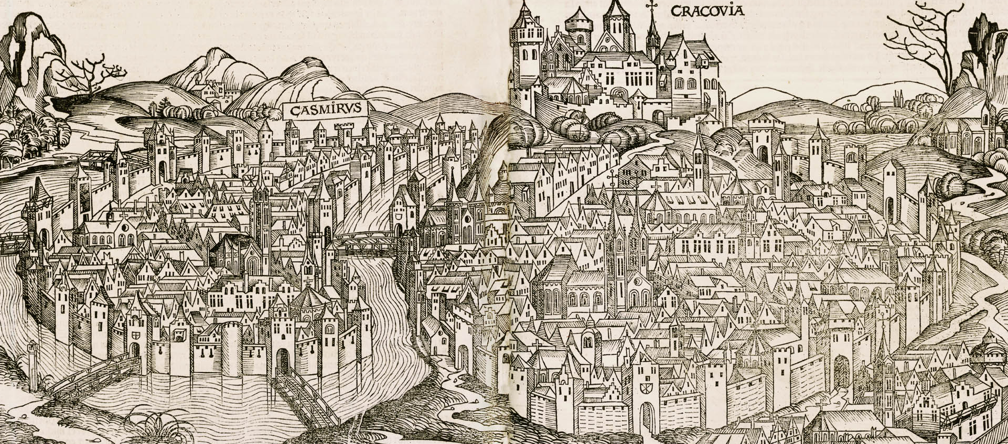
Concerns & Questions

Slide 30
Looking Beyond WYD
Post-WYD WYDUSA Leader Guide entries
#WYDWednesdays continue after WYD
Pilgrim Journal entries continue after WYD
Pilgrimage Mobile App continues after WYD
Connecting Krakow & Stateside Pilgrims
Post-WYD Catholic Apostolate Center Resources
National Conversations and Encuentros

Slide 31
Closing Prayer
All-powerful God,
You always show mercy
towards those who love you and
you are never far away for those who seek you.
Remain with your servants as they travel
on this holy pilgrimage and
guide their way in accord with your will.

Slide 32
Closing Prayer
Shelter them with your protection by day,
give them the light of your grace by night,
and as their companion on the journey,
bring them to their destination in safety.
We ask this through Christ our Lord. Amen.

Slide 33


FOR MORE INFO: WYD@USCCB.ORG
WWW.WYDUSA.ORG

