Slide 1
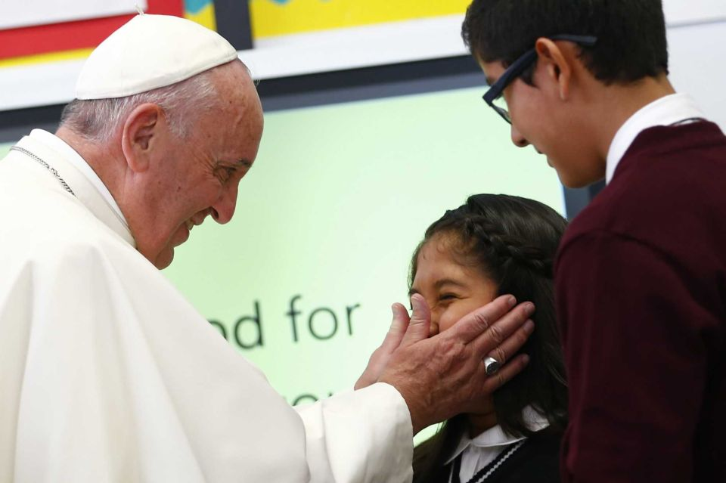

World Congress on Catholic Education

Slide 2
Aims of the Congress
To celebrate Gravissimum
educationis and Ex corde
Ecclesiae
To relaunch the Church’s
commitment to the field of
education
Notes:
50th Anniversary of Gravissimum Educationis
25th Anniversary of Ex corde Ecclesiae
Catholic centres of education are not only “dispensers of skills: but, by their very nature, are intrinsically places of encounter, dialogue and mutual growth, within a process of education for life that is open to others in view of the common good.
Opportunity to renew our passion for education
to analyze together the challenges of today
to give renewed vigor to our work and
to compare our experiences with those of so many others
The Congress gives rise to a stronger sense of belonging to one great educational project that forms a common bond: schools and universities, associations and groups involved in the formation of young people according to a Christian vision.

Slide 3
Four Principle Themes:
1) Identity and Mission
2) Stakeholders
3) Formation of Formators
4) Challenges
Notes:
Identity and Mission
…there is a firm link between the identity of education institutions and their mission.
Catholic educational mission flows from the very identity of the Church
Stakeholders …form a community.
The essential traits that characterize this community are those that mark it as professional, educational and evangelizing.
Formation of Formators … key to building up these communities
Teachers – solid professional expertise, aware of their role in education, …
compelled to love the service to culture that they render to society…
a shared formation which can absorb and harmonize the specific formative contribution both of religious and laity
Challenges – holistic formation
formation and faith
peripheries – the poor and the new forms of poverty

Slide 4
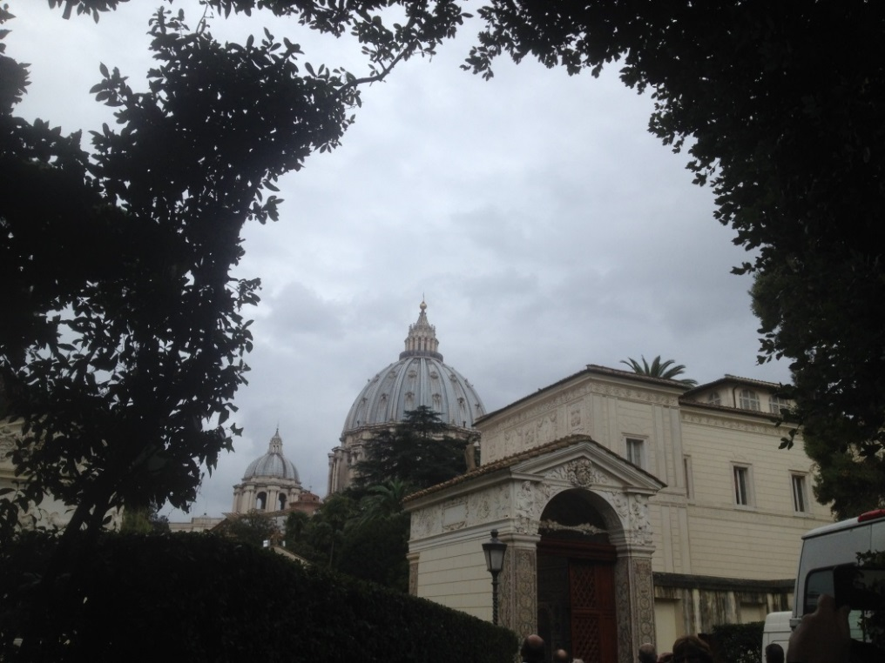
Challenges
“We must promote a holistic educational journey for young people, entrusting its care and guidance to an educating community of evangelization, within which the identity of the educational institution itself is lived out in a life-giving way.”
Three challenges emerged:
A holistic formation
Challenge of formation and faith
Challenge of the peripheries – the poor
and the new forms of poverty

Slide 5
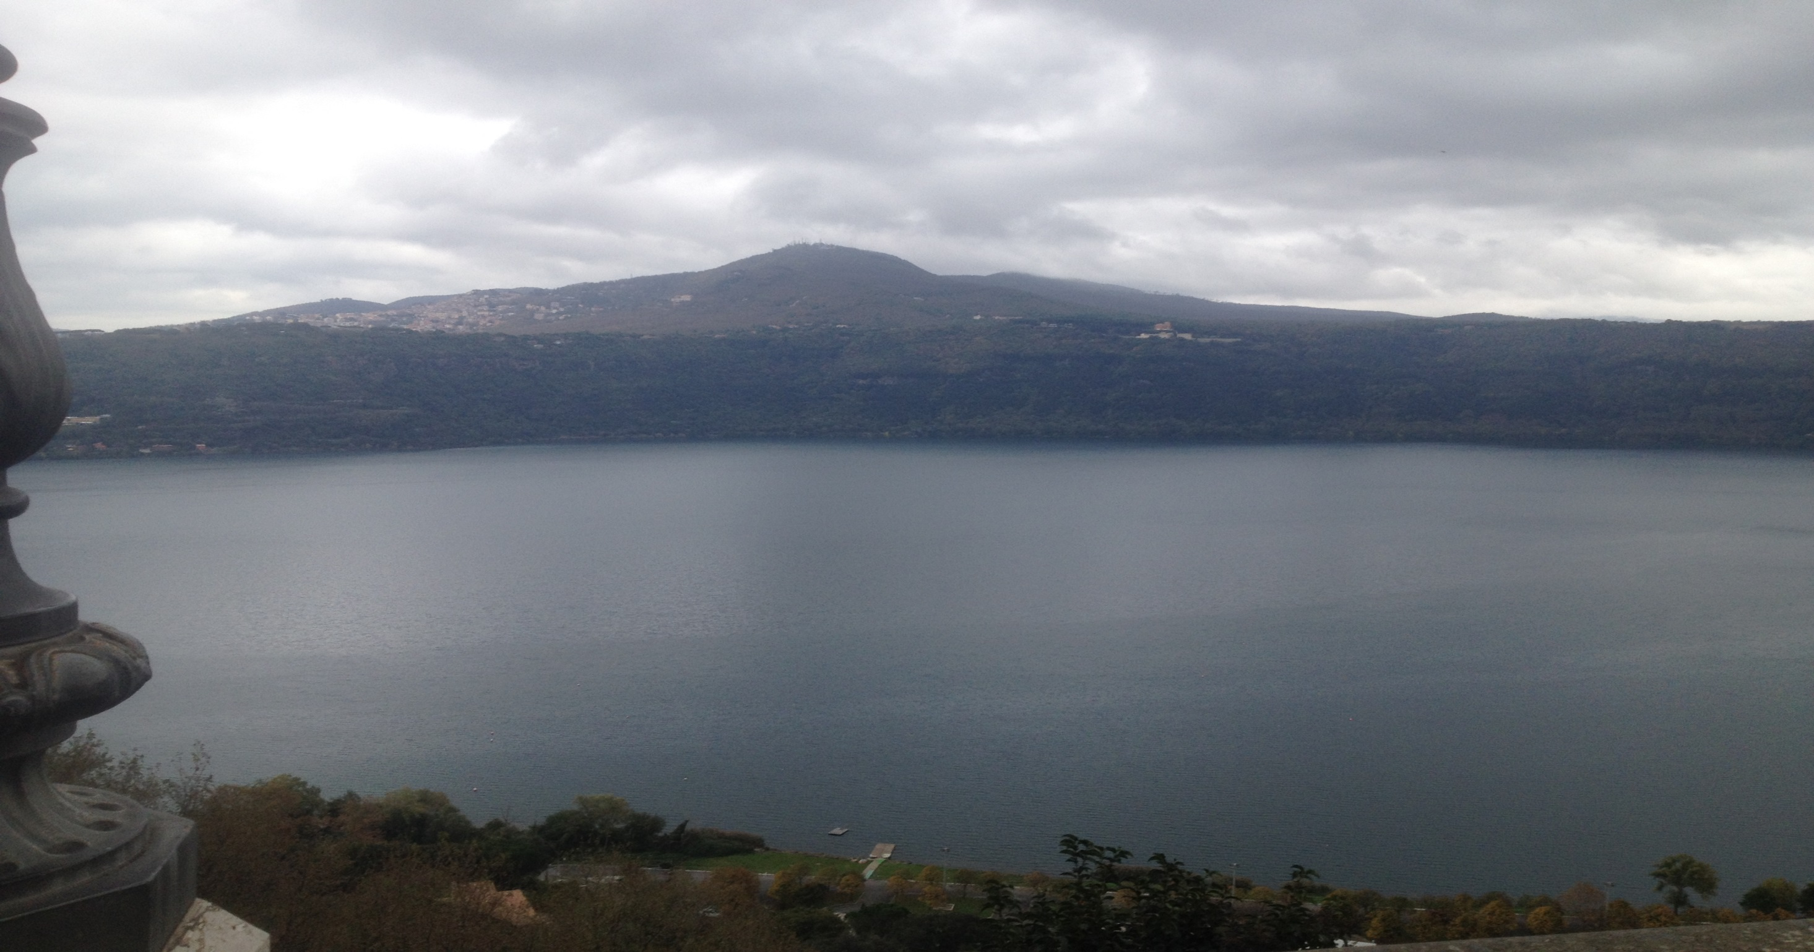

Slide 6
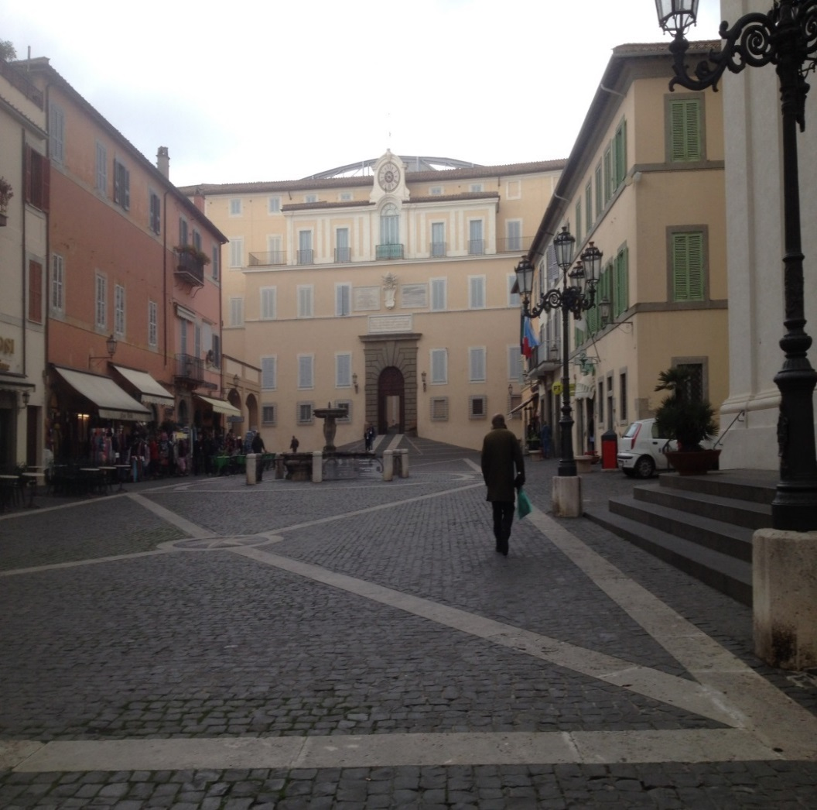
The Congregation for Catholic Education
…aims to provide services to promote the educational mission
of the Church:
Education for all - UNESCO objectives
Prepare a manifesto for education
Research School for Higher Formation
Gravissimum Educationis Foundation
Council for Educational Cooperation
Notes:
210,000 schools and the 1865 Catholic and ecclesiastical universities
60 million students
Objectives of UNESCO - world forum “Education 2030” (held May 2015)
dedication to education for all
goals for 2030: extending access to those excluded
guarantee inclusion and equality
assure quality of teaching
improve learning
promote life-long learning
Manifesto – updated format – anthropological foundation and basic values
Research School for Higher Education
Educating to encounter and Solidarity
Foundation – to promote research, study and publications on Church thought with reference to education and Catholic culture in schools and universities
Council – foster cooperation (Catholic and other schools) good of all mankind
universities work together, promote international gathering

Slide 7
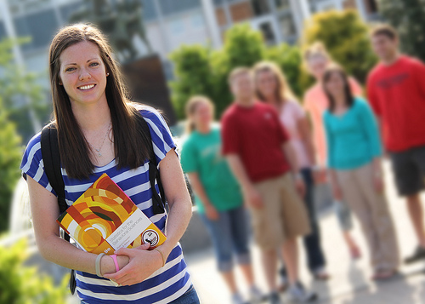

Message of Pope Francis to Educators
Holistic education
Notes:
The complete value of education –
introducing people to the whole truth
to educate in a Christian manner is to lead young people forward in human values present in all that is real, …transcendence.
the greatest crisis in education, from a Christian point of view, is the closing off from the transcendence – more than the some of its parts
we must educate in a human manner, but keeping our perspectives open

Slide 8

Message of Pope Francis to Educators
New pathways
Notes:
Rebuild the educational alliance, (family/school and state/school - broken)
“education has also become too selective and elitist.”
Holistic – harmony of 3 languages: head, heart and hands
think, feel and do
Inclusive: concepts and ATTITUDES and VALUES
Reasonable Risk taking
walking: 1 foot planted on what is known / 1 moving to unknown
Congregation for Catholic Education – Goals for 2030
education for all – guarantee inclusion and equality
Council for Educational Cooperation
every means should be employed to foster suitable cooperation between Catholic schools, and between these and other schools that collaboration should be developed which the good of all mankind requires.
let the universities also endeavor to work together by promoting international gatherings, by sharing scientific inquires with one another.

Slide 9
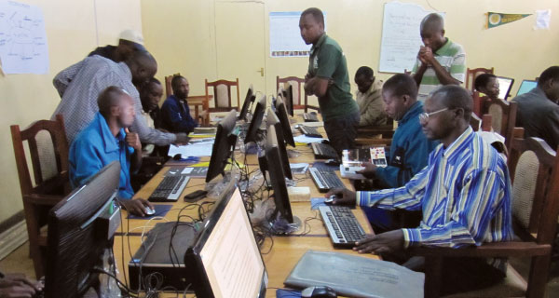
Message of Pope Francis to Educators
Peripheries
Notes:
The challenge of the peripheries…
“go there and make them grow in humanity, in intelligence, in values, in attitudes,
so that they can go forward and bring to others experiences they do not know.”
Recognize their experience: survival, cruelty, hunger, and of injustice. They have a wounded humanity. … our salvation comes from the wounds of wounded man on the Cross. They, from those wounds, draw wisdom, if there is a good education to lead them forward.
Breaking down the walls
“The greatest failure that an educator can have is to educate ‘within the walls’” To educate within the walls: walls of a selective culture, the walls of a culture of security,
the walls of a social category that is affluent and no longer goes forward.”
[Arrupe College, U Dayton, Marquette – neighborhood]
Re-thinking the works of mercy
Is mercy only giving alms?
In education, how can I perform works of mercy?
What can I do so that the love of the Father enters into our educaitonal effort?

Slide 10
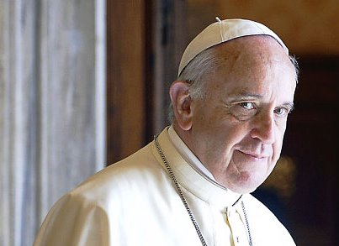
What can I do so that this Love of the Father enters into our educational efforts?
Notes:
Rethinking Mercy, not just charity
Is mercy only giving alms?
In education, how can I perform works of mercy?
What can I do so that the Love of the Father enters into our educational effort?
Corporal works: feed the hungry, give drink to the thirsty, cloth the naked, visit the sick and prisoned, bury dead, shelter homeless
Spiritual works: instruct the ignorant, counsel the doubtful, admonish sinners, bear wrongs patiently, forgive offenses, comfort the afflicted,
pray for the living and the dead

