Slide 1

Energizing the Black Catholic Community
It’s a Year Round Ministry
Wednesday March 18, 2015
2:00 – 3:00 pm Webinar

Slide 2
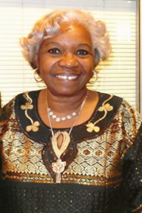

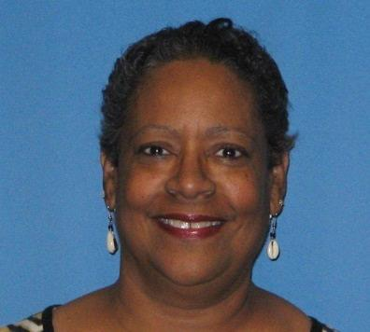
WELCOME & INTRODUCTIONS
Sr. Jannette Pruitt
Dr. Ansel Augustine
Donna Grimes

Slide 3
Outline
Hear the experiences of two Directors who sponsor a variety of programs throughout the year
Celebrate Traditional Events, Grow in Faith and Do More
Our presenters also will address a particular focus area
Hear great ideas from other webinar participants
Q&As

Slide 4

Meet Sr. Jannette Marie Pruitt, OSF – Archdiocesan Coordinator for Black Catholic Ministry
St. Francis Oldenburg, IN 2007
DRE & Pastoral Associate at
St. Rita Parish
Certified Master Catechist, Xavier NOLA
Congress XI Project Coordinator
National Black Sisters Conference Board
Interregional African American Catholic Evangelization Conference
Lady of Peter Claver, Court 97
Ambassadors of the Word
Ku Pona DaDa (Get Well Sister)
Board member of the National Black Sisters Conference

Slide 5

Meet Ansel J. Augustine, D.Min
Archdiocesan Director, Black Catholic Ministries
Previously, Associate Director/Coordinator of Black Youth & Young Adult Ministry
Faculty, Institute of Black Catholic Studies at Xavier NOLA
National Federation of Catholic Youth Ministry Board
Youth Minister, St. Peter Claver Parish
Contributor to the new African American Catholic Youth Bible

Slide 6
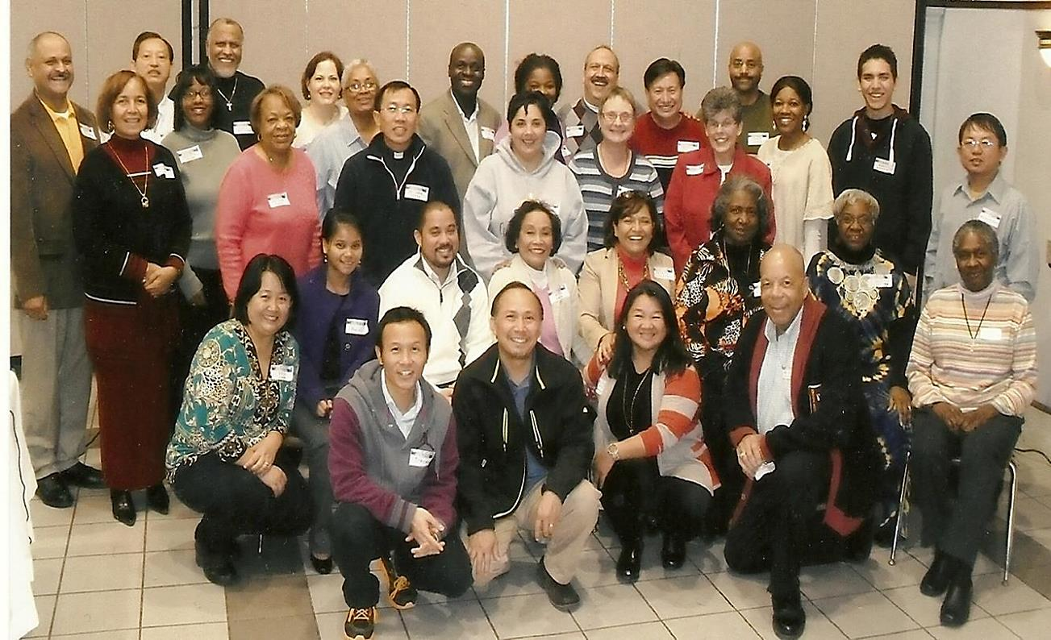
Archdiocese of Indianapolis
Advisory Committee of the Archdiocese Inter-Cultural Ministry

Slide 7
Archdiocese of Indianapolis
Traditional Celebrations
Martin Luther King Jr.’s Birthday
Black History Month
Black Catholic History Month/All Saints Day Celebration
Kwanzaa

Slide 8
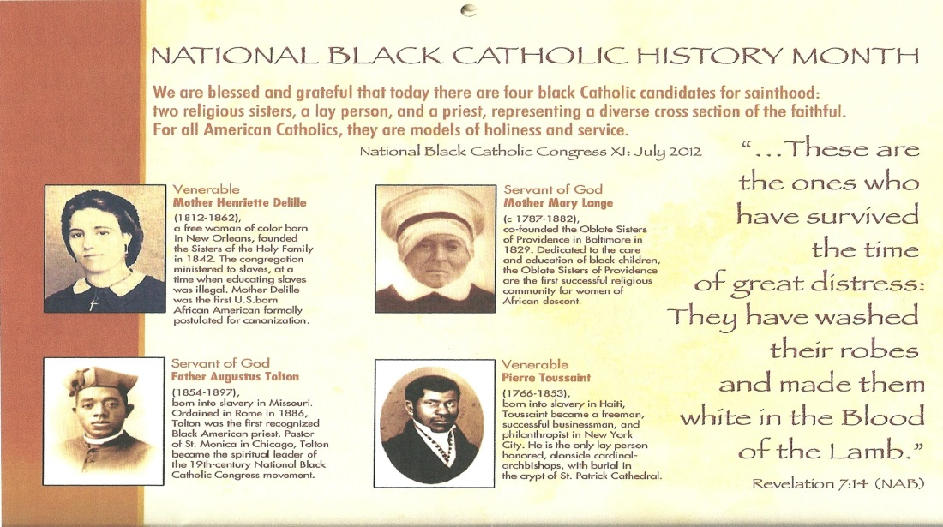
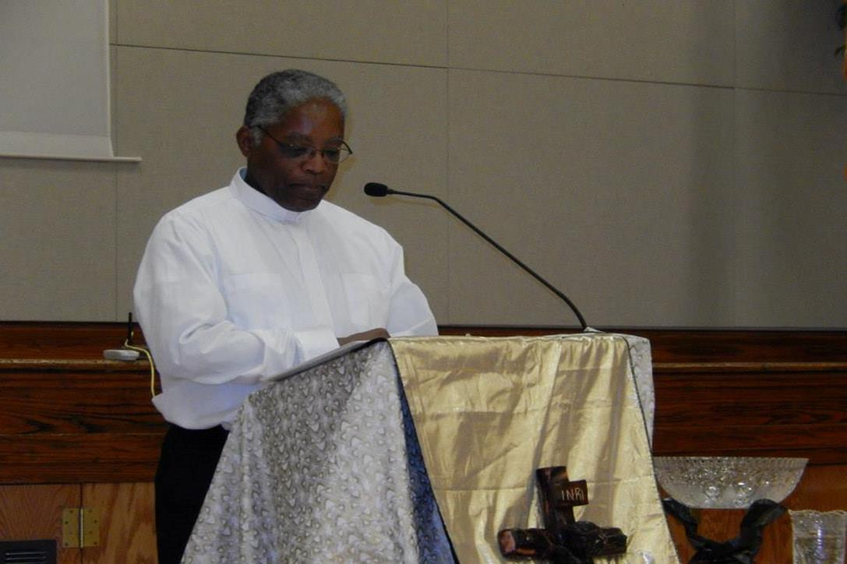

Slide 9
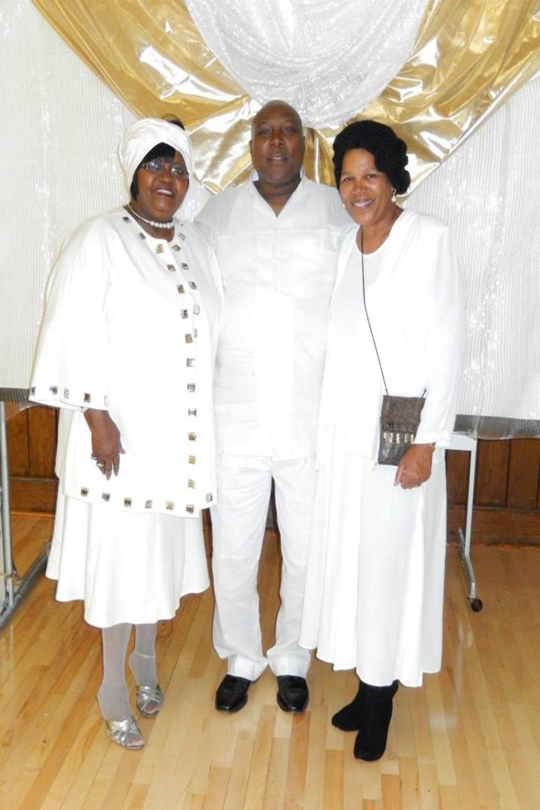
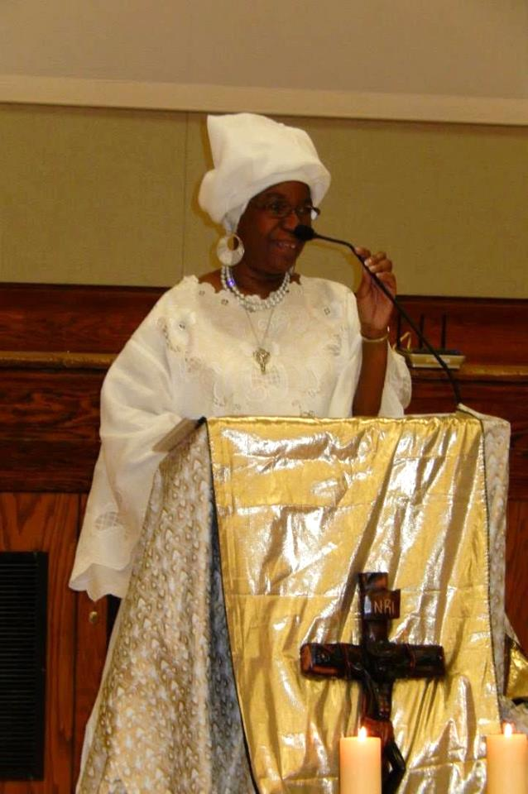
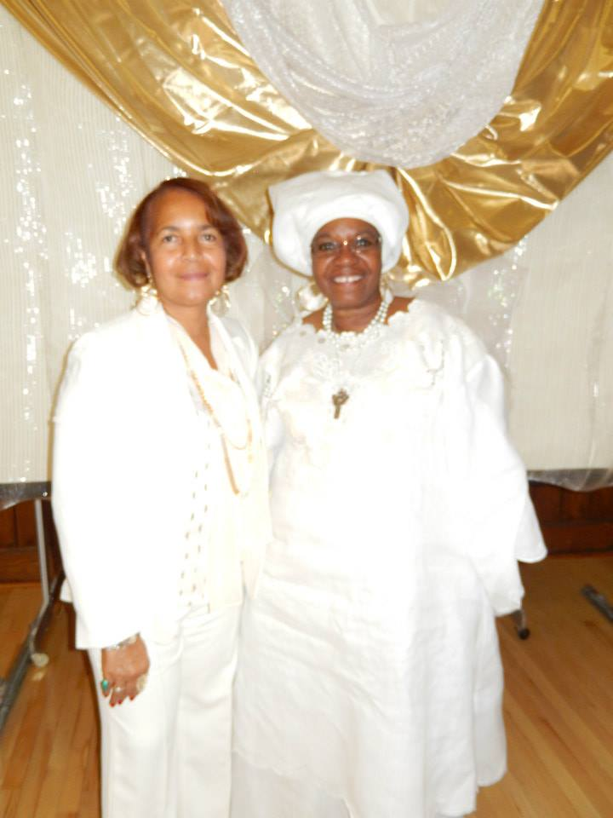
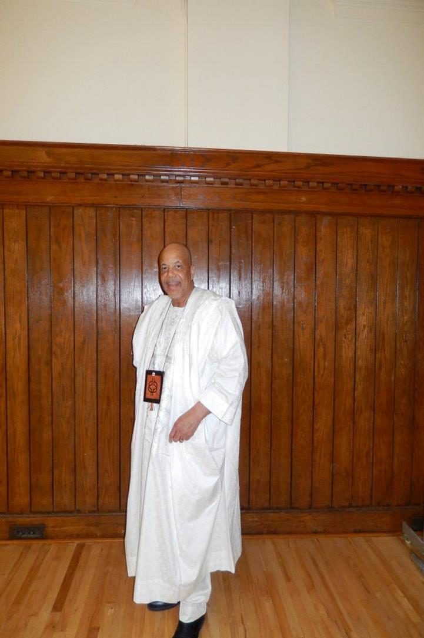
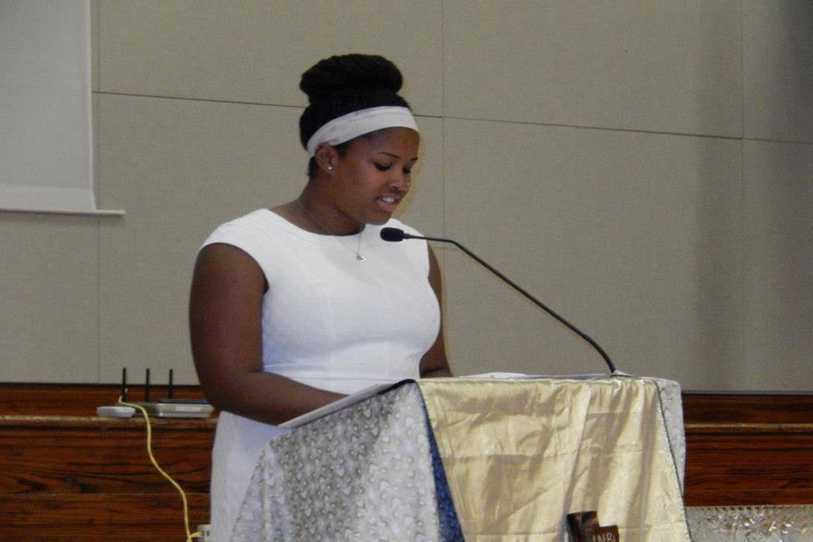
1st Annual All Saints Day Celebration

Slide 10
Archdiocese of Indianapolis
Additional Programs
March: Women’s History Month
Fr. Boniface Hardin Black Catholic Theology and Spirituality Program
Lunch and Learn Program
St. Martin de Porres Mass and Celebration

Slide 11
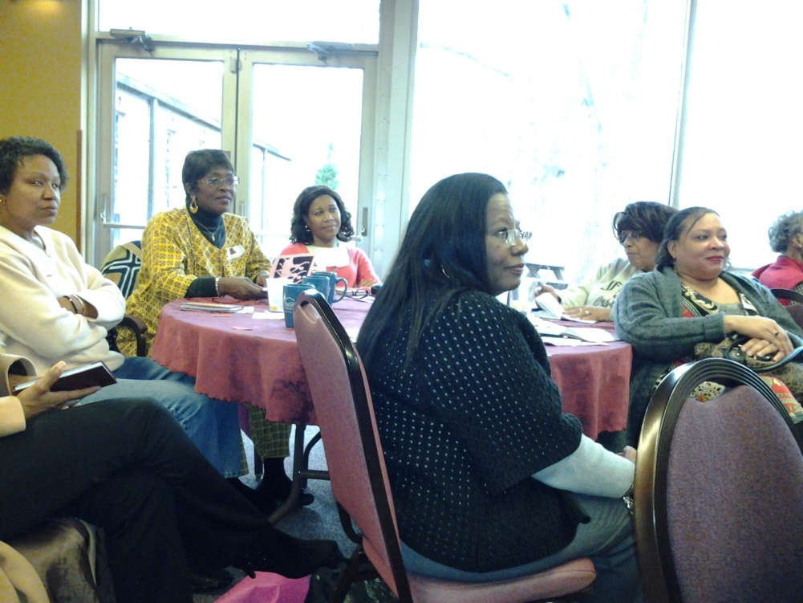
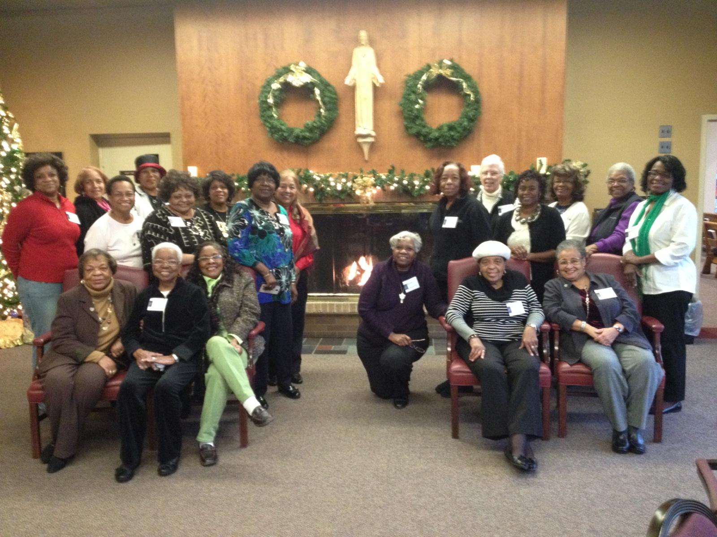
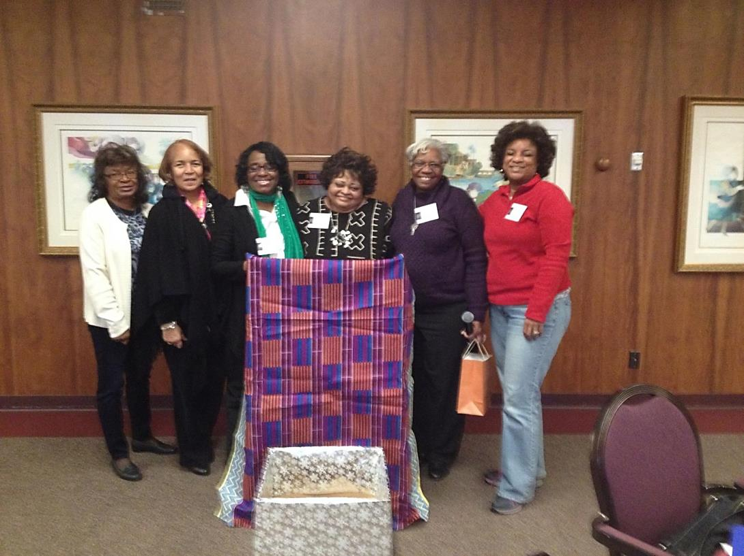
Women’s History Month and activities through out the year
Photos: Advent African American & African Black Catholic Women’s Retreat 2015

Slide 12
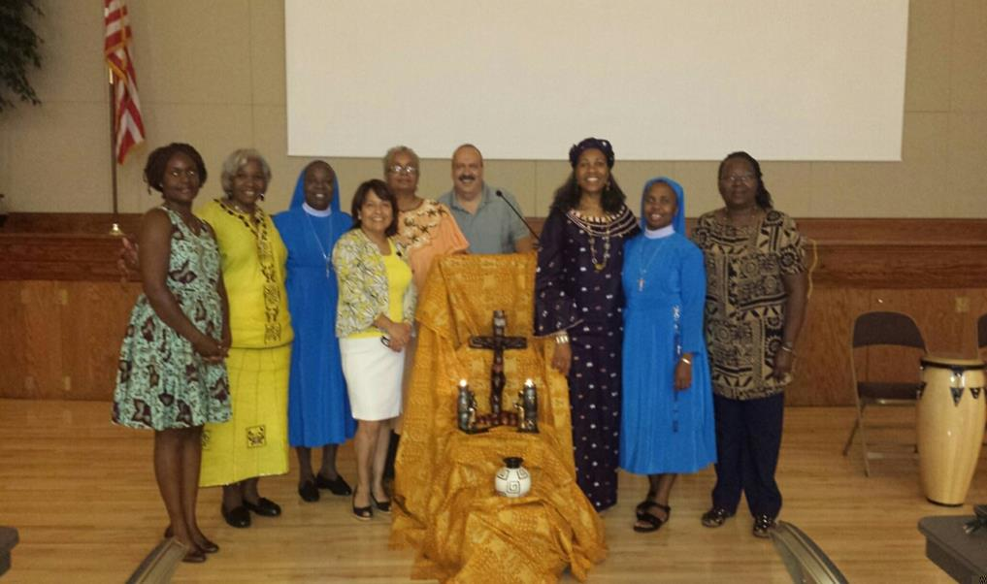
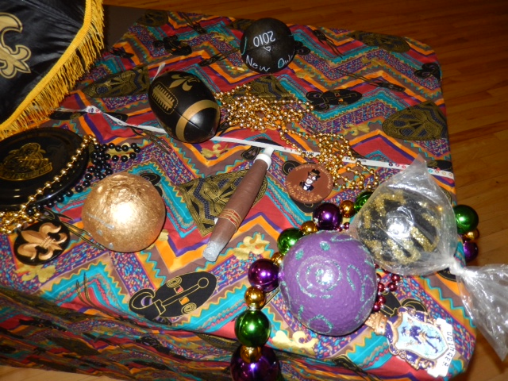
Fr. Boniface Hardin Black Catholic Theology & Spirituality Program
Lunch and Learn
Fr. Boniface Hardin

Slide 13
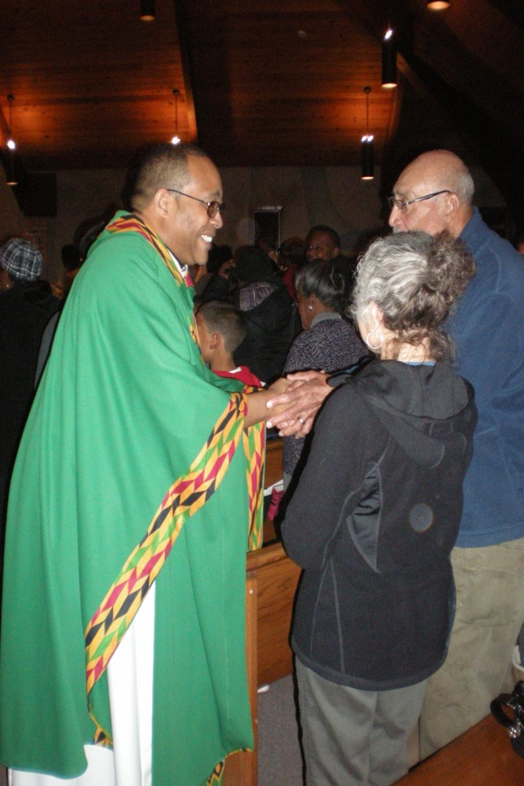
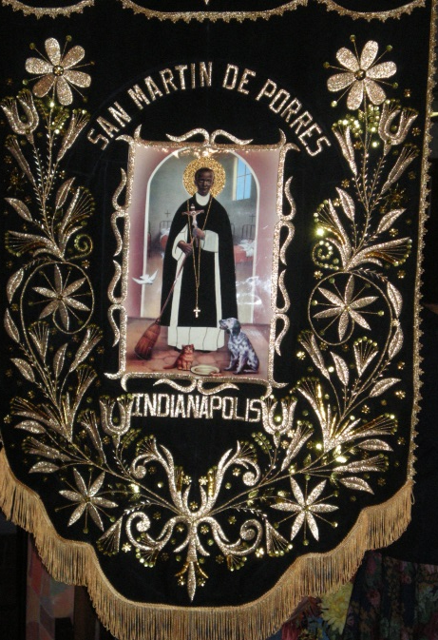
St. Martin de Porres Mass and Celebration

Slide 14
Archdiocese of Indianapolis
Building the Network
Knights and Ladies of Peter Claver
Black Expo
National Black Catholic Congress Post-Reflection Day
Youth Jam
Evangelization
African American and African Black Catholic Women

Slide 15


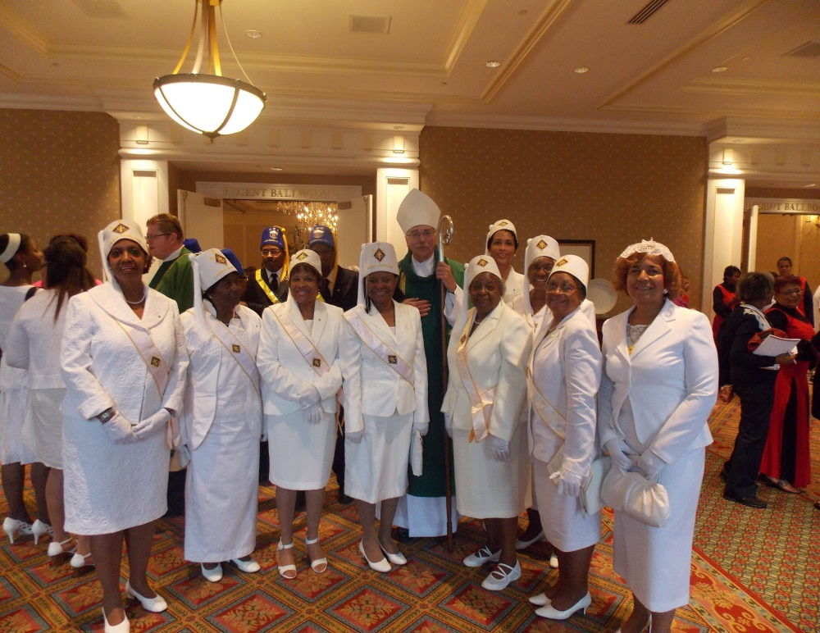
Knights and Ladies (pictured) of Peter Claver
Black Expo

Slide 16
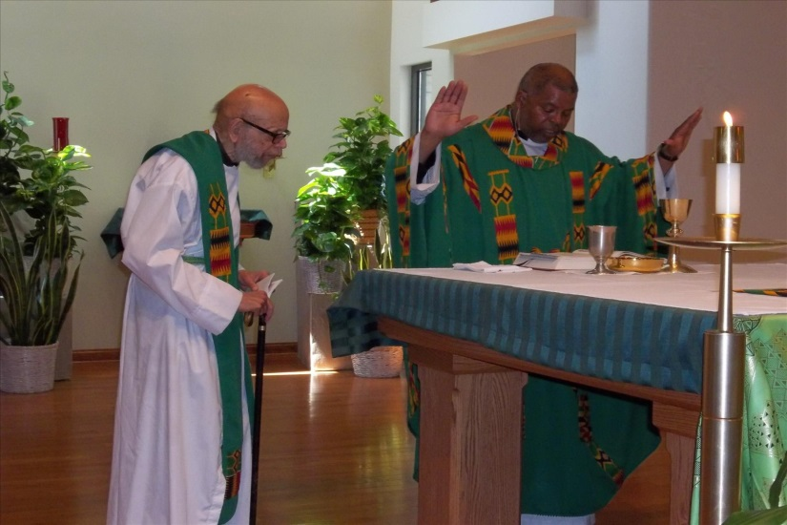
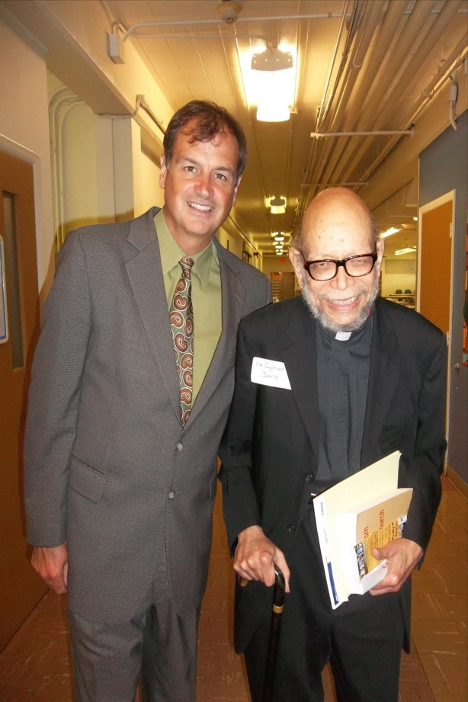
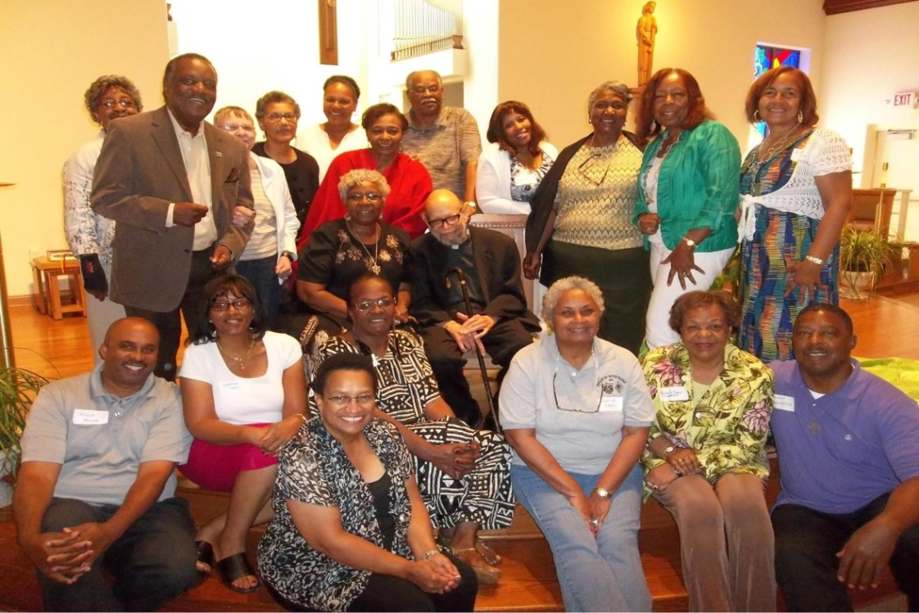
Post Congress Reflection Day
Fr. Charles Smith and Fr. Cyprian Davis, OSB
Mr. Gary B. Agee (A Cry for Justice: Daniel Rudd and His Life in Black Catholicism, Journalism, and Activism, 1854–1933) and Fr. Cyprian Davis, OSB

Slide 17
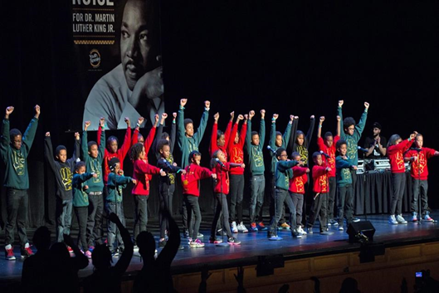
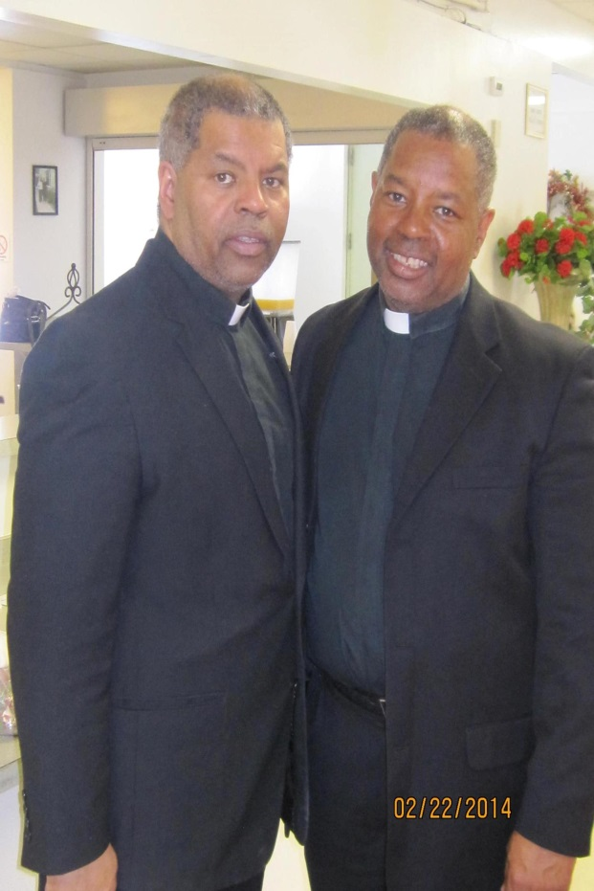
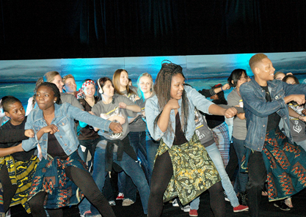
Youth
The Global Children
Fr. Charles Smith and Fr. Chester Smith

Slide 18
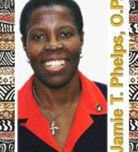
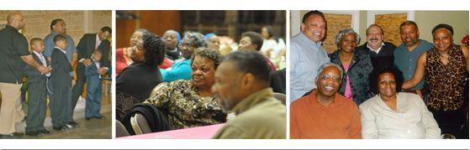
Evangelization of the Black Catholic Community

Slide 19
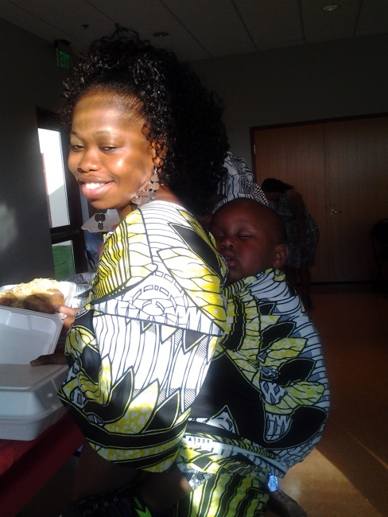
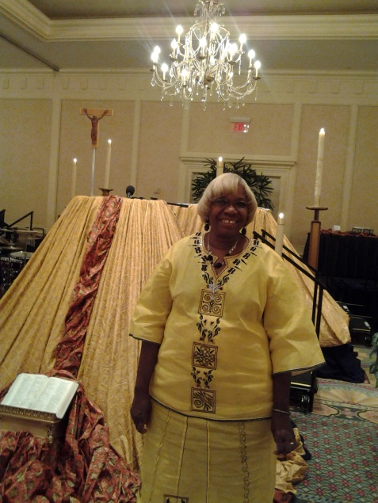
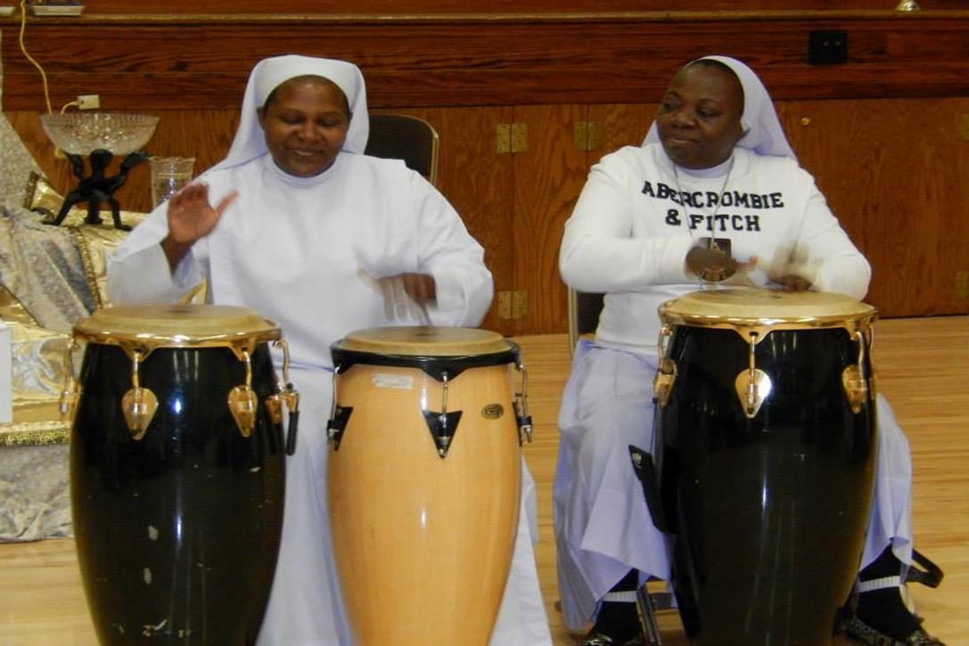
African American and African Women

Slide 20
Evangelization of the Black Catholic Community

Slide 21
Youth
The Global Children
Fr. Charles Smith and Fr. Chester Smith

Slide 22
Post Congress Reflection Day
Fr. Charles Smith and Fr. Cyprian Davis, OSB
Mr. Gary B. Agee (A Cry for Justice: Daniel Rudd and His Life in Black Catholicism, Journalism, and Activism, 1854–1933) and Fr. Cyprian Davis, OSB

Slide 23
Knights and Ladies (pictured) of Peter Claver
Black Expo

Slide 24
Archdiocese of Indianapolis
Building the Network
Knights and Ladies of Peter Claver
Black Expo
National Black Catholic Congress Post-Reflection Day
Youth Jam
Evangelization
African American and African Black Catholic Women

Slide 25
St. Martin de Porres Mass and Celebration

Slide 26
Archdiocese of Indianapolis
Building the Network
Knights and Ladies of Peter Claver
Black Expo
National Black Catholic Congress Post-Reflection Day
Youth Jam
Evangelization
African American and African Black Catholic Women

Slide 27
Knights and Ladies (pictured) of Peter Claver
Black Expo

Slide 28
Post Congress Reflection Day
Fr. Charles Smith and Fr. Cyprian Davis, OSB
Mr. Gary B. Agee (A Cry for Justice: Daniel Rudd and His Life in Black Catholicism, Journalism, and Activism, 1854–1933) and Fr. Cyprian Davis, OSB

Slide 29
Knights and Ladies (pictured) of Peter Claver
Black Expo

Slide 30
Archdiocese of Indianapolis
Building the Network
Knights and Ladies of Peter Claver
Black Expo
National Black Catholic Congress Post-Reflection Day
Youth Jam
Evangelization
African American and African Black Catholic Women

Slide 31
St. Martin de Porres Mass and Celebration

Slide 32
Archdiocese of Indianapolis
Building the Network
Knights and Ladies of Peter Claver
Black Expo
National Black Catholic Congress Post-Reflection Day
Youth Jam
Evangelization
African American and African Black Catholic Women

Slide 33
Knights and Ladies (pictured) of Peter Claver
Black Expo

Slide 34
Post Congress Reflection Day
Fr. Charles Smith and Fr. Cyprian Davis, OSB
Mr. Gary B. Agee (A Cry for Justice: Daniel Rudd and His Life in Black Catholicism, Journalism, and Activism, 1854–1933) and Fr. Cyprian Davis, OSB

Slide 35
Knights and Ladies (pictured) of Peter Claver
Black Expo

Slide 36
Post Congress Reflection Day
Fr. Charles Smith and Fr. Cyprian Davis, OSB
Mr. Gary B. Agee (A Cry for Justice: Daniel Rudd and His Life in Black Catholicism, Journalism, and Activism, 1854–1933) and Fr. Cyprian Davis, OSB

Slide 37
Youth
The Global Children
Fr. Charles Smith and Fr. Chester Smith

Slide 38
Evangelization of the Black Catholic Community

Slide 39
African American and African Women

Slide 40
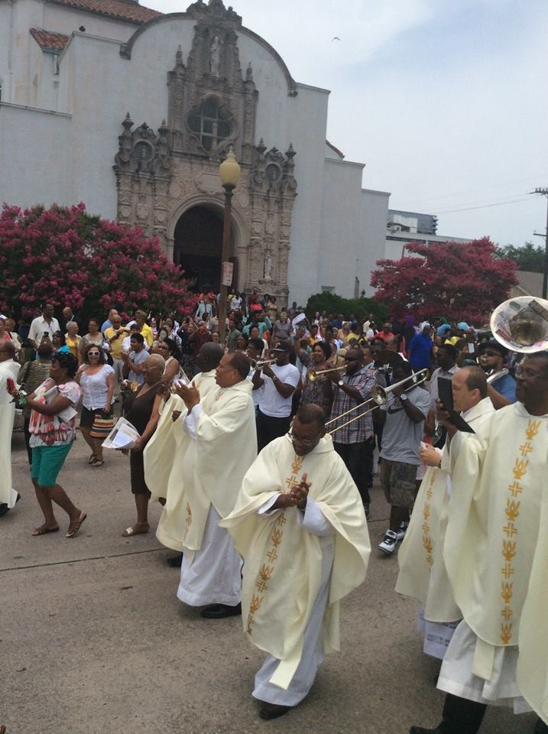
Archdiocese of New Orleans

Slide 41
Archdiocese of New Orleans
Traditional Celebrations
MLK Day On Not Off
Black Saints Celebration
Kwanzaa Prayers
Ordination of Black Clergy

Slide 42
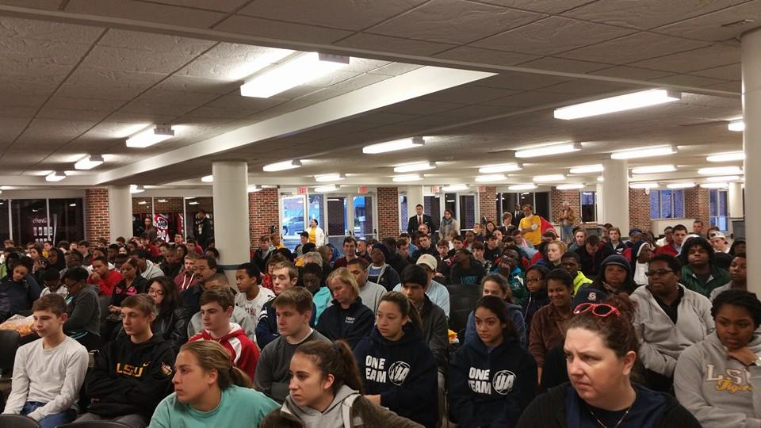
MLK Day On Not Off

Slide 43
Archdiocese of New Orleans
Traditional Celebrations
MLK Day On Not Off
Black Saints Celebration
Kwanzaa Prayers
Ordination of Black Clergy

Slide 44
Archdiocese of New Orleans

Slide 45
Archdiocese of New Orleans
Traditional Celebrations
MLK Day On Not Off
Black Saints Celebration
Kwanzaa Prayers
Ordination of Black Clergy

Slide 46
MLK Day On Not Off

Slide 47
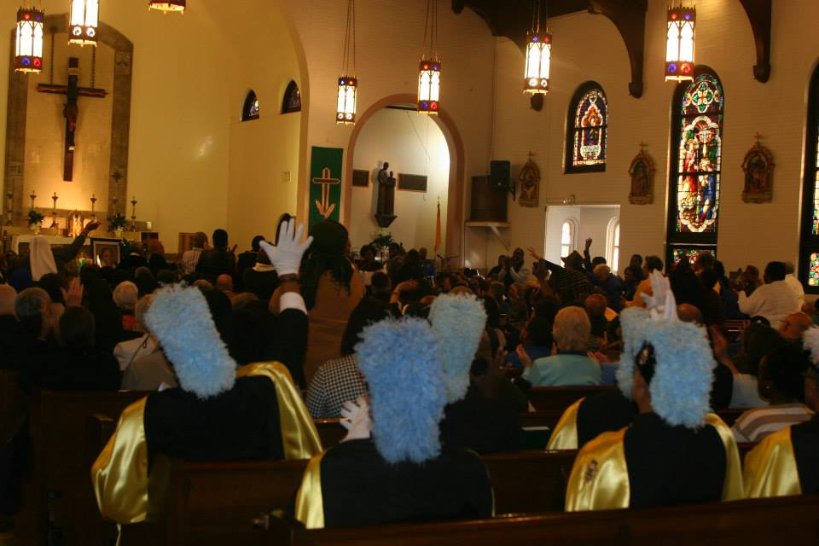
Black Saints Celebration 2014

Slide 48
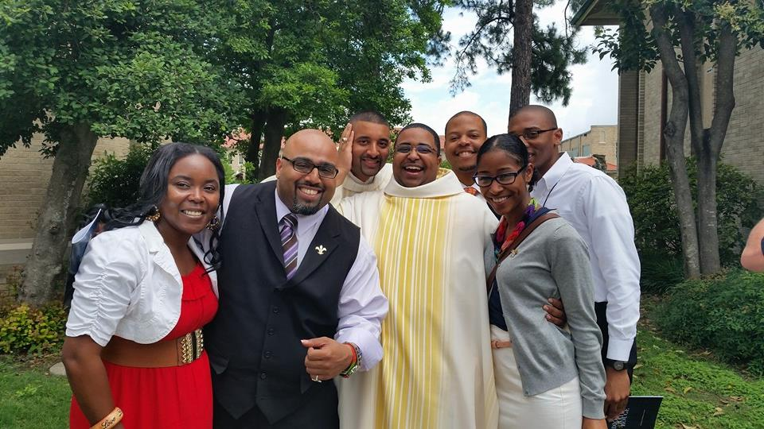
The Joy of Holy Life

Slide 49
Archdiocese of New Orleans
Additional Programs
Listenfest
Imani Team
Youth & Young Adult Revival
Habari Gani Retreat
Synod Session w/Young Adults

Slide 50
The Joy of Holy Life

Slide 51
Archdiocese of New Orleans
Additional Programs
Listenfest
Imani Team
Youth & Young Adult Revival
Habari Gani Retreat
Synod Session w/Young Adults

Slide 52
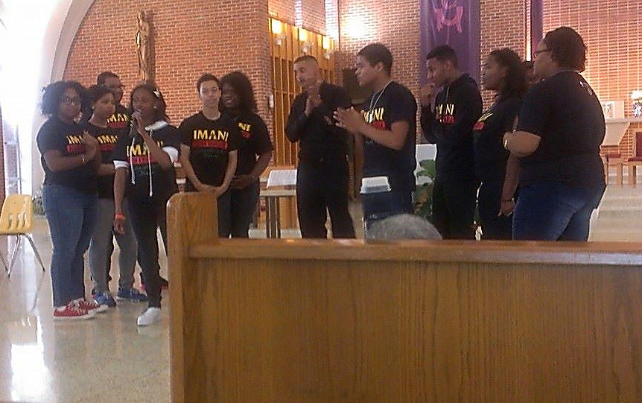
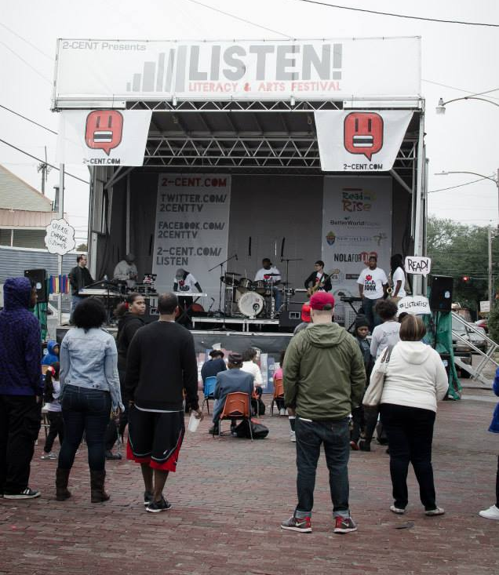
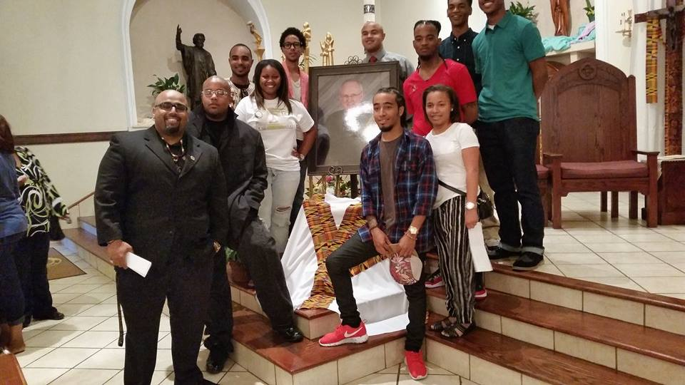

Slide 53
Archdiocese of New Orleans
Building the Network
Gather with OBM Directors of South Louisiana
Gospelfest
Psalm 119 Step Team at NCYC
Synod Session w/Young Adults
#blacklivesmatter movement

Slide 54
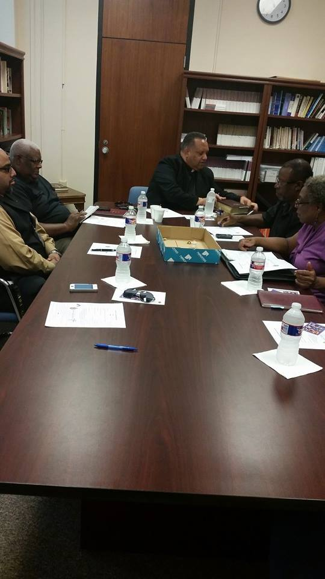
Regional Directors Meeting

Slide 55
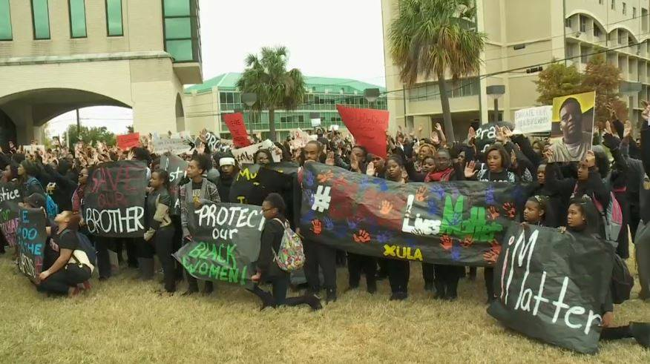
#blacklivesmatter movement

Slide 56
Regional Directors Meeting

Slide 57
#blacklivesmatter movement

Slide 58
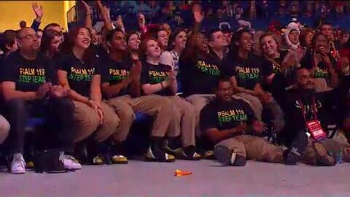
Psalm 119 Step Team at National Catholic Youth Conference

Slide 59
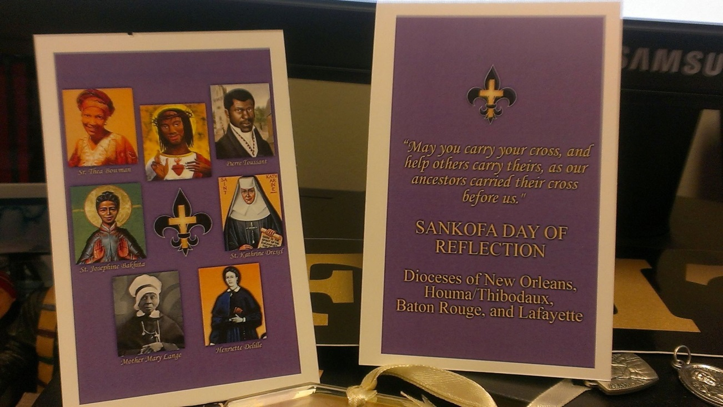
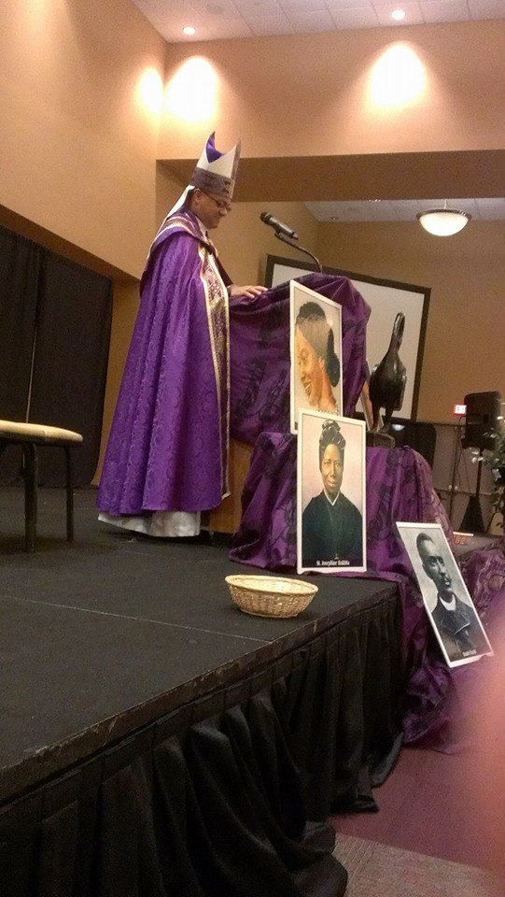
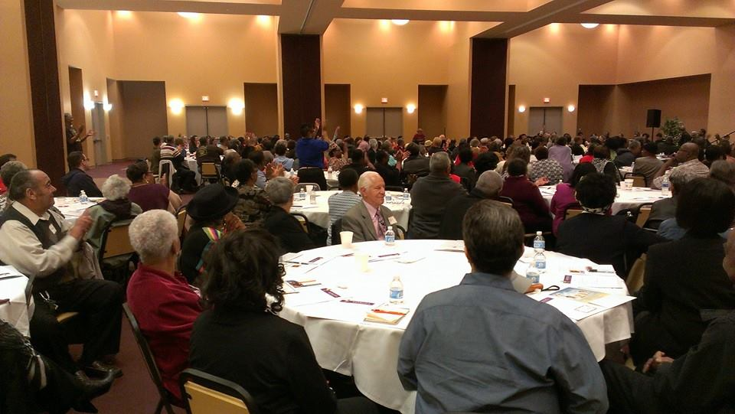

Slide 60
Questions for the Presenters on Part 1
…Let’s move on to Part 2

Slide 61
Sr. Jannette
The Fr. Boniface Hardin Institute
A new initiative from the Intercultural Ministry Office
Committed to developing and supporting pastoral leaders,
men and women of all races and backgrounds, for the
Black Catholic ministry in the Archdiocese of Indianapolis

Slide 62
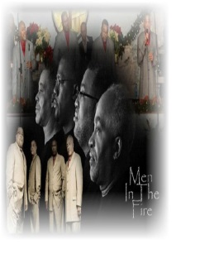
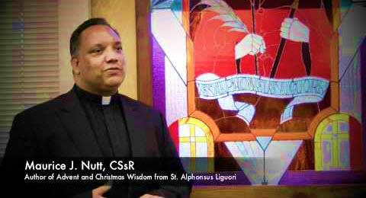
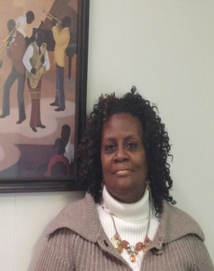
In Memory of Fr. Boniface Hardin OSB
Gospel Concert
Men in the Fire and Phyllis Walker

Slide 63
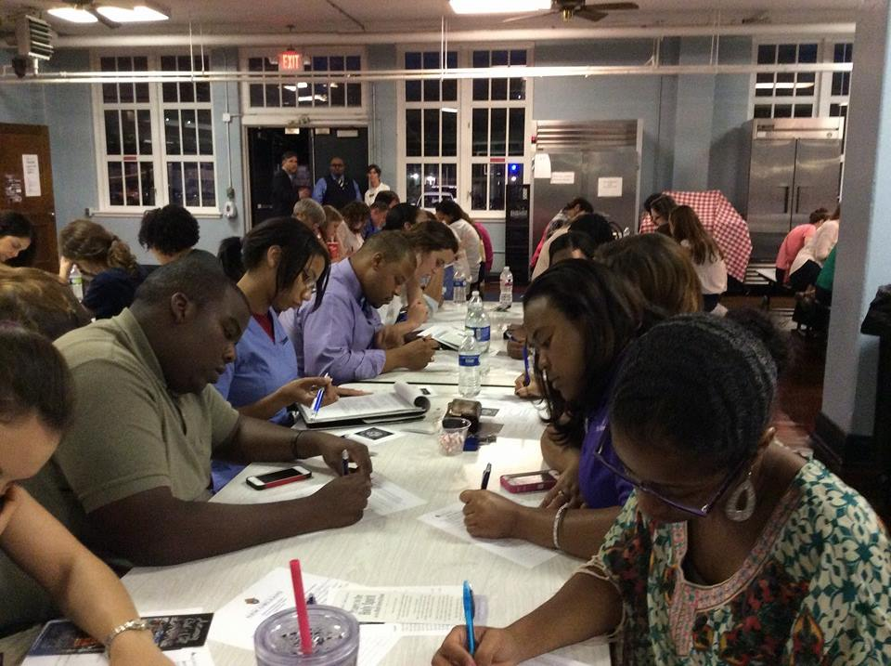
Dr. Ansel
Reaching Youth and Young Adults

Slide 64
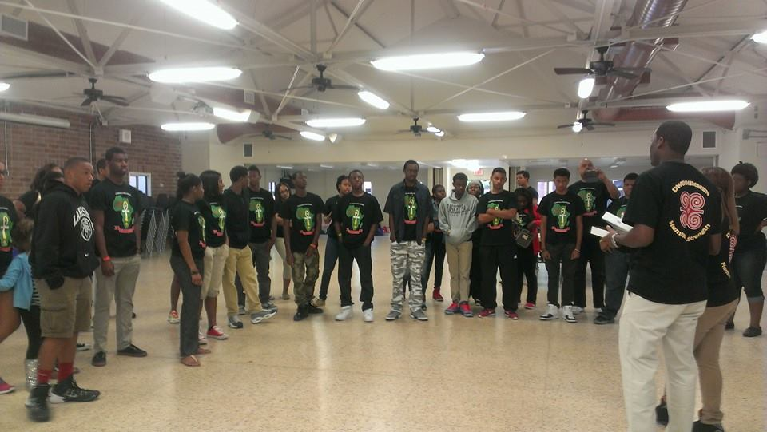
Where Do Youth and …

Slide 65
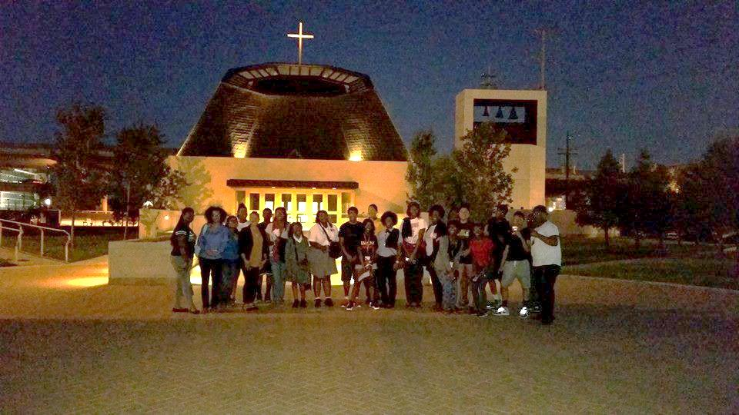
…Young Adults Fit In?

Slide 66
Questions for the Presenters on Part 2
…Now let’s hear other winning ideas

Slide 67
THANK YOU!
To review this webinar later visit http://www.usccb.org/issues-and-action/cultural-diversity/african-american/resources/index.cfm

Slide 68
Thank you to our presenters: Sr. Jannette Marie Pruitt and Dr. Ansel Augustine
And to all our participants
Andrew Lyke
Corinne Monogue
David O.
Deacon Al Turner
Deacon Bill Bradley
Ella Johnson
Johnnie Dorsey
Laruen Green
Linda Duhon-LaCour
Lorna DesRoses
Stephanie Bernard
Yolanda Taylor-Burwell

