Slide 1

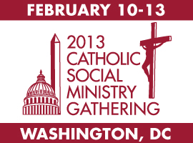
Catholic Social Ministry Gathering
“Getting Ready to Go to Capitol Hill”
Department of Justice, Peace, and Human Development
United States Conference of Catholic Bishops
www.catholicsocialministrygathering.org
Notes:
Welcome to the 2013 Catholic Social Ministry Gathering Webinar. You are a vital part of making this Gathering a success. We want to give you the tools to help you prepare for the Gathering, especially those of you who are first time participants.
This presentation will give you an update of where we are now with the Gathering and emphasize the importance of the Hill visits to our Catholic social action outreach. It will provide some information about Congress and give you tips on how to better organize your Hill visits.
Remember, we want to be a resource for you, as you are our force-multipliers in advocating for legislation that reflects Catholic social teaching.

Slide 2
Prayer
Gracious and loving God, let your Spirit be with us today. Hear our prayers, and increase in us the will to follow your Son Jesus. Help us to draw on the resources of our faith as we use the opportunities of our democracy to shape a society more respectful of the life, dignity, and rights of the human person, especially the poor and vulnerable. We ask this through Jesus Christ, your Son, who lives and reigns with you in the unity of the Holy Spirit, one God forever and ever.
R. Amen
Copyright © 2008, Department of Justice, Peace and Human Development, USCCB, Washington, DC.; www.faithfulcitizenship.org

Slide 3
Hill Visits: Do They Matter?
YES!
Last year, we asked Congress to...
Extend Unemployment Insurance:
by the end of the week, it was included in the final spending package
Release Palestinian Humanitarian Aid:
shortly after CSMG, Congress began releasing the aid in installments
Local perspectives and stories are impactful and powerful
Hill Visits build new relationships, strengthen existing relationships, and enhance our ability to be effective advocates
As a constituent, your message can be more effective and carries much credibility with Members of Congress
Notes:
Advocacy with Congress is a vital part of the CSMG. Not only do our voices matter, they are NECESSARY. Our voices advocate the needs of poor and vulnerable people, who often don’t have a voice at the policymaking table.
You elect these Members of Congress. Responding to constituents is a high priority for Members and their staff.
An in-person visit from a constituent is likely to have the most influence on a Member of Congress who has not yet made a firm decision on an issue, even more than individualized letters or email messages.
Relationships and Resources
More important than the statistics of how many visits were made is the quality of the visits--was your delegation able to make a connection with the Congressperson or a key staffer? This relationship will allow you to follow-up throughout the year.
These visits can and should open up a dialogue--the Member of Congress and their staff get to hear the Church’s views on how public policy impacts poor and vulnerable people. At the same time, they can use you as a sounding board for ideas or ask for information about the district and the programs you work on related to an issue. In other words, one of our goals is to establish ourselves as resources for Congressional offices.

Slide 4
A Word of Thanks &
Preview of 113th Congress
Thank you for accepting the call to serve and lead your state’s congressional visits.
113th Congress - many new members
House – Republican controlled 232-197
Senate – Democrat controlled 53-45, 2 Ind
Notes:
Whether you are coming to the Gathering for the first time or are a returning participant, you are key to providing a voice for poor and vulnerable people. As a group, we bring moral principles, everyday experience, broad presence, many structures and people with us as we make our case on Capitol Hill.
We appreciate your hard work in participating in these Hill visits, since this is our one opportunity each year to descend on Congress en masse and make the Catholic voice heard. These Hill visits are so important as they tie what we do here in February to your ongoing efforts during the rest of the year to advocate in your districts and dioceses.
The 112th Congress was heavily partisan which hampered the legislative process, and the prospects for future bipartisanship in the 113th Congress are grim. In this atmosphere it is all the more important for us as Catholics to reach across party lines to advocate the needs of the poor and vulnerable.
Our leaders must hear our message to protect the poor, even in times of tight budgets. We cannot balance the budget on the backs of the poor.

Slide 5
Scheduling Visits
Request appointments for Tues., Feb. 12 from 1:30 – 4:30 pm (Hill reception in Capitol Hill from 4:30 – 6:30 pm)
Visit our Legislative Action Center to find contact information
Some may require faxing or e-mailing your request
Follow-up with a call to be sure your request is received
When confirmed, please share date, time, location and with whom you are meeting with your state captain
Notes:
We aim to have most of the appointments on Capitol Hill on February 12 1:30-4:30 pm , however it may be that your Member of Congress or key staffer is only available another time. You will have to be flexible as one of the key objectives of the CSMG is to build the relationship with your Members of Congress.
If you don’t know how to contact your Congressional representatives, visit our Legislative Action Center (link above).
Some offices may ask that you fax or email your request for a meeting. The Tips for State Captains to Guide CSMG Delegations in Setting up Hill Visits has a sample text for requesting an appointment. Once you’ve sent in your fax/email, be sure to follow-up with a phone call to the scheduler to make sure your request was received.
When you receive a response, be sure to get the name of the person you’re meeting with and call again a day or two in advance to confirm the date, time, and location, and the name of the person you’re meeting.

Slide 6
Coordinating Visits
You are responsible for scheduling your visit with your Representative (particularly first-timers).
Provide information on visits you have scheduled to your state captain, who will send it on to us.
If you are part of a large CSMG group, check with your state captain as to which visits you will make and who will speak.
If you have a small CSMG group in a state with many Members, check with your state captain about prioritizing visits.
Let us know soon if your CSMG group needs someone to accompany you on a visit.
Notes:
Make sure to schedule a meetings with your Representatives, preferably in early to mid afternoon of Tuesday, February 12, 2013. Your state captain will set up meetings with your Senators and try to schedule them for later that afternoon.
Send information on your scheduled visits to your state captain. S/he will compiled all the appointments and send it to Tom Mulloy (tmulloy@usccb.org). Use this template: www.usccb.org/about/justice-peace-and-human-development/catholic-social-ministry-gathering/upload/Congressional-Visits-Template.xls
We’ll try to maintain a master list of all appointments so that if for some reason, someone is ill and has to drop out, we have a record of what appointments were made and can hopefully work with you to have someone else step in.
Depending on the number of CSMG participants from your state and the size of your Congressional delegation, you’ve got different issues to deal with. If you have a large CSMG group, you will need to decide who goes on which visits. If you have a small CSMG group but are from a medium to large size state in terms of population and number of Members, it’s likely that you will not be able to schedule visits with all of your Members – you’ll need to prioritize. We’ll send a list called “Prioritizing Members of Congress for Hill Visits” out shortly to help you decide who to see.
Most importantly for small delegations, we’ve asked state captains if they want someone from USCCB, CRS, or Catholic Charities USA to accompany you on the visits. Your state captain can contact Ginny Farris (vfarris@usccb.org) and Tom Mulloy (tmulloy@usccb.org) and we will have a partner for your delegation.

Slide 7
Getting a Head Start
Know about the Catholic presence in your district
Do your research (Member’s website, bio, committee assignments, and news releases for his/her priorities)
Find out if your Senator or Representative has taken a position on the Hill issues
If they are new to Congress, check on any statements made during campaigning
Check the CSMG website for backgrounders and talking points on the advocacy isssues.
Hill packet (Hill Message, leave behind and invitation)
Notes:
As you prepare for the Hill visits, get the facts about the Catholic presence in your district and state. How many Catholics are there? How many Catholic schools and hospitals are there? What type of social services do Catholic institutions provide in your community? All this will help buttress your case. Make sure that everyone in your delegation has this information down pat or bring along a crib sheet.
We don’t ask you to become subject experts on the issues; you can always refer people back to us. But always remember that you ARE experts on the community and the people you serve. Speak honestly and from the heart, as concerned citizens.
If you are a 1 or 2 person delegation, you will have to prioritize which Members to contact and focus your efforts.
Ultimately, remember that you are the constituent from the district or the state. You will carry information about your meetings on the Hill back to the larger Catholic population in your state. You have a valuable commodity – your vote.

Slide 8
Helpful Resources
www.CatholicSocialMinistryGathering.org click on Capitol Hill Visit information (Hill packet , directories, and helpful links)
Be sure to review Talking Points (also with each registration packet). Backgrounders for all issues will be posted on CSMG website.
THOMAS: Library of Congress website to look up bills and voting records
New House members of 113th Congress
Notes:
Additional Resources
www.govtrack.us
www.congress.org
www.politico.com
www.rollcall.com
www.thehill.com
www.nationaljournal.com
Social media: Check for Members’ Facebook, Twitter, and YouTube pages

Slide 9
Your Feedback Matters
Fill out Hill Visits Report form
More information is better than less, but please one form per congressional visit.
Feel free to e-mail any additional information you want to share about a particular visit.
If you’re leaving early, you can fill out the form electronically or fax it to us.
Notes:
We will be providing paper copies of Hill Visits Report Forms to all state delegations. One person should fill out this form for each visit made on Capitol Hill. Although there’s only one report for each visit made to a Congressional office, all who participated in the visit should chime in with their impressions of the discussion. These paper forms can be turned in as you enter the Hill Reception as that will help us track how many visits were made.
Many meetings may be more of a familiarization exercise – you’re telling the Member/staffer about the Catholic presence in your district/state and about the issues that are of concern to Catholics and they are basically listening but being non-committal as to their position.
But sometimes you may have a more substantive discussion with the Member or staffer. If that happens, there’s room on the back of the Hill Visits Report Form to add more comments. Among the information sought: Did the member or staffer express any strong opinions about the issues? Did they mention any bills or legislation they have sponsored related to the issues? Did they say what issues will absorb most of their attention and energy? What questions did they ask? What other information does the member or staffer want? This more detailed information will help to shape our advocacy efforts. The Hill Visits Report Forms can also be completed on one of the hotel’s computers or when you return home but we do need feedback on your visits.

Slide 10
Other Updates
Logistics – factor in travel times to Capitol Hill
Let us know how we can improve (evaluation forms appreciated)
Notes:
This year, the Gathering is being held at the Washington Marriott Wardman Park Hotel, which is located away from Capitol Hill, near the Woodley Park Zoo metro stop. It will take about 50 minutes to go from the hotel to the Capitol South metro stop that is closest to the House office buildings (Cannon, Longworth and Rayburn). It will take about 35 minutes to go from the hotel to the Union Station metro stop that is closest to the Senate office buildings (Russell, Dirksen and Hart). Walking from the House to the Senate side of Capitol Hill will take 15-20 minutes. Please take these travel times into account when setting up your appointments.
If you have someone with a disability that needs to take a cab to the Hill, we have set aside a limited amount of funds for that purpose. Please let those at the CSMG Registration Desk know.
After the Gathering, we’ll send out a brief questionnaire asking what worked and what could have been improved. We always want your input into how the Hill visits portion of the Gathering could be better so we can factor that into our planning for the future.

Slide 11
Reaching out to the Media
Discuss how to engage traditional and social media channels with your diocesan communications director
Use prepared media templates
*Media Advisory * Press Release
Bring a camera to the CSMG and take pictures of your delegation with the Member.
Ask for help with coverage in diocesan newspaper, on the diocesan website, and in local secular media
Use social media. Blog or tweet during the Gathering and from Capitol Hill
Notes:
As you try to expand awareness of Catholic social action concerns and attract attention to our issues, here are some tips on reaching out to the media.
Identify what is unique about your story, e.g. “Don’t balance the budget on the backs of the poor” and tie this statement to your experience about domestic and international poverty.
Media channels include: diocesan website, local/regional Catholic media, social media channels within the diocese, secular/local media. Your diocesan communications director can help you with placing your story.
While you’re at the CSMG, you can tweet or blog about what’s happening in your visit, using local/regional social media channels, and that may attract your legislator’s attention. A number of Congressional offices track social media to gauge public opinion.
Here are links (above) to media advisory and press release templates, but try to personalize the story about your meeting so it doesn’t sound like boilerplate. Get a quote from your elected official to add to the news release.
Take photos of your group with your elected official, perhaps in front of his/her office by the state flag. Having a picture makes your story/press release more attractive to media outlets, including diocesan newspapers.

Slide 12
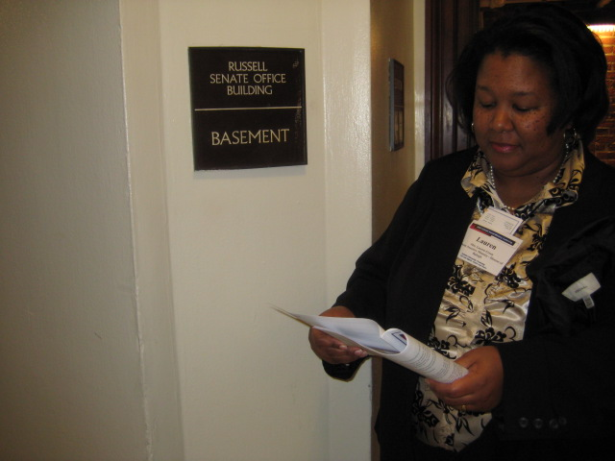
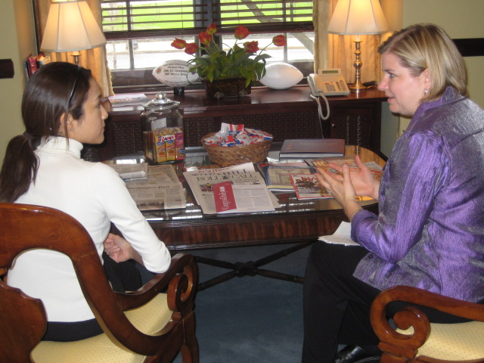
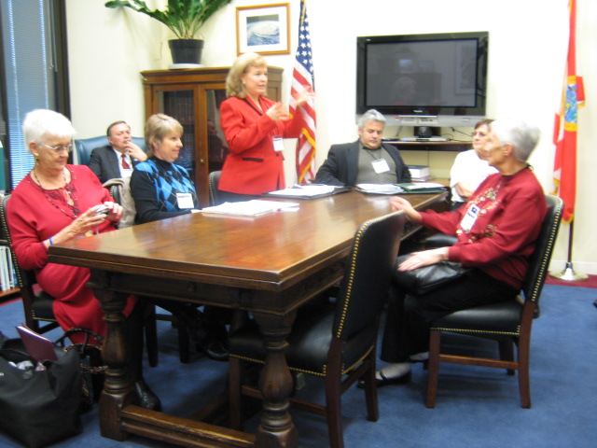
Putting Our Faith into Action
Notes:
We appreciate your willingness to lead your state delegations in this important combined effort to live our faith by raising the needs of the poor and the most vulnerable to members of Congress.
So often they are forgotten in the policy and budget debates. Your participation and leadership helps to give a voice to the voiceless on Capitol Hill.

Slide 13
Thank You
See you in February!
Brought to you by the
CSMG Hill Visits Subcommittee:
Joanne Dunne (NCCW), Ginny Farris (USCCB), Ron Jackson (CCUSA), Tom Mulloy (USCCB), Tina Rodousakis (CRS),
Terry Thames (USCCB)
Notes:
Email contact for CSMG Capitol Hill Visits Committee:
Joanne Dunne
jdunne@nccw.org
Ginny Farris
vfarris@usccb.org
Ron Jackson
rjackson@CatholicCharitiesUSA.org
Tom Mulloy
tmulloy@usccb.org
Tina Rodousakis
Tina.Rodousakis@crs.org
Terry Thames
tthames@usccb.org

