Slide 1
CCLV Report
2012
Midwest Association of Theological Schools
Rev. W. Shawn McKnight, S.T.D.
Executive Director
Secretariat of Clergy, Consecrated Life and Vocations

Slide 2
CCLV Report
2012
Midwest Association of Theological Schools
Power Point Available @
www.usccb.org/priestlyformation

Slide 3
USCCB Statement on Preaching
Pope Benedict XVI calls for improved homilies
  Sacramentum Caritatis
  Verbum Domini
Expands upon Fulfilled in Your Hearing
  Explicit encouragement for doctrinal & catechetical preaching
  Addresses challenges for the homily in the New Evangelization
  Directed to priests, deacons & those involved with the initial and ongoing formation of clergy

Slide 4
USCCB Statement on Preaching
Draft submitted by CCLV to USCCB Administrative Committee, with the support of Divine Worship, Doctrine, Cultural Diversity, Ecumenism, Evangelization & Catechesis, Canonical Affairs, and Communications
Approval granted for consideration by the bishops at the November 2012 Plenary Assembly
If approved by the bishops, publication in January in English/Spanish; implementation in fall 2013

Slide 5
USCCB Statement on Preaching
CCLV Workshop for teachers of homiletics
  June 24-25, 2013
  Notre Dame

Slide 6
2012 Ordination Survey
Youth involvement in Church is critical for vocations;
Low encouragement reported from youth/young adult/ campus ministers;
Underrepresentation of Hispanic/Latinos and strong representation of Asians.
Trending younger still; average 34.6, median 31
27% have college debt; average $21,125, median $18,000

Slide 7
Consideration of a Vocation to
Priesthood and Religious life among Never-married
U.S. Catholics
--CARA Survey Report
Rev. Shawn McKnight, S.T.D.
Executive director
USCCB Secretariat of Clergy, consecrated life & vocations
October 2012
MATS

Slide 8


funding

Slide 9
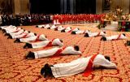
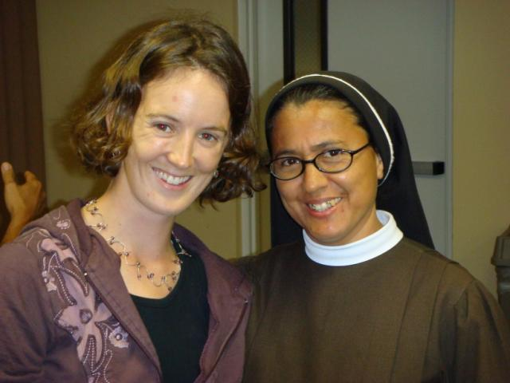
Why this survey?
Annual Surveys of the
Newly Ordained
Annual Surveys of Perpetually Professed

Slide 10
Annual Surveys of New
Priests (2012) /Religious (2011)
2012 2011 National
Caucasian / White
71% 66% 58%
Hispanic / Latino
15% 10% 34%
Asian / Pacific Islander
9% 17% 4%
African / African American
3% 4% 3%

Slide 11
Country of Birth of Ordinands
United States 71%
Vietnam 5%
Columbia 5%
Mexico 4%
Poland 3%
Philippines 2%
El Salvador 1%
Other 9%
Total Hispanics / Latinos: 15%
U.S. Born Hispanics / Latinos:
<5%

Slide 12
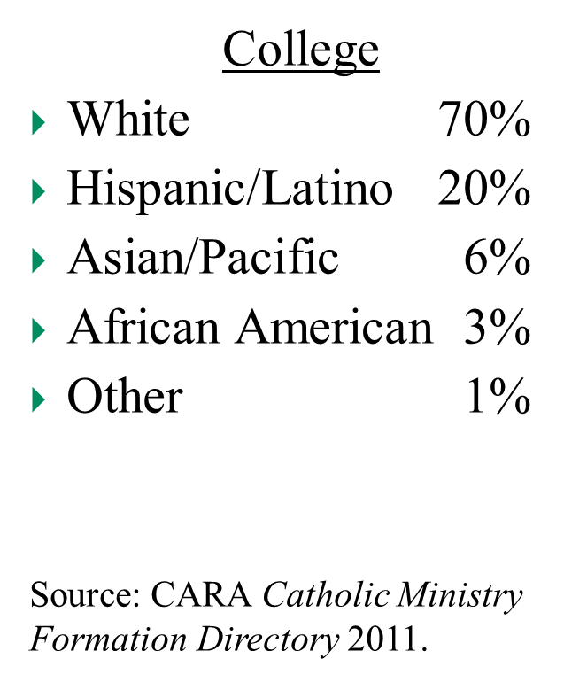
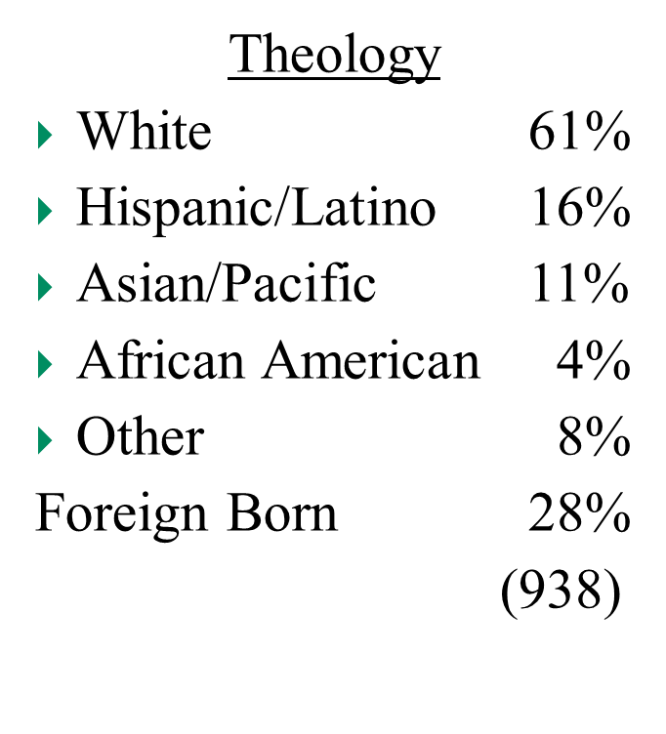
Future Ordination Classes
(Seminarians 2011)

Slide 13
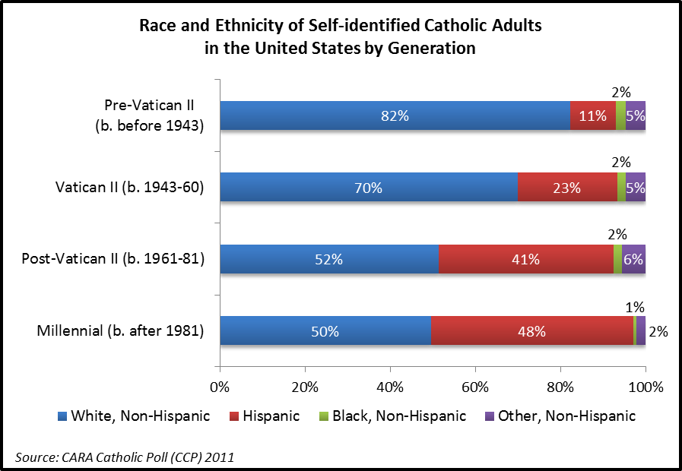
Percentage of Hispanics by generation

Slide 14
Vocation survey Characteristics
Self-administered, national online survey, conducted in May and June 2012
Scientific, probability-based sample of 1,428 never-married Catholics ages 14 and older [R: 14-35]
Males (average age 26):
Six in ten are adults (18 or older)
36% Non-Hispanic white adults, 20% non-Hispanic white teens
19% Hispanic adults, 16% Hispanic teens
4% Other race adults, 5% other race teens
Females (average age 28):
Seven in ten are adults (18 or older)
40% Non-Hispanic white adults, 15% non-Hispanic white teens
22% Hispanic adults, 13% Hispanic teens
7% Other race adults, 3% other race teens

Slide 15
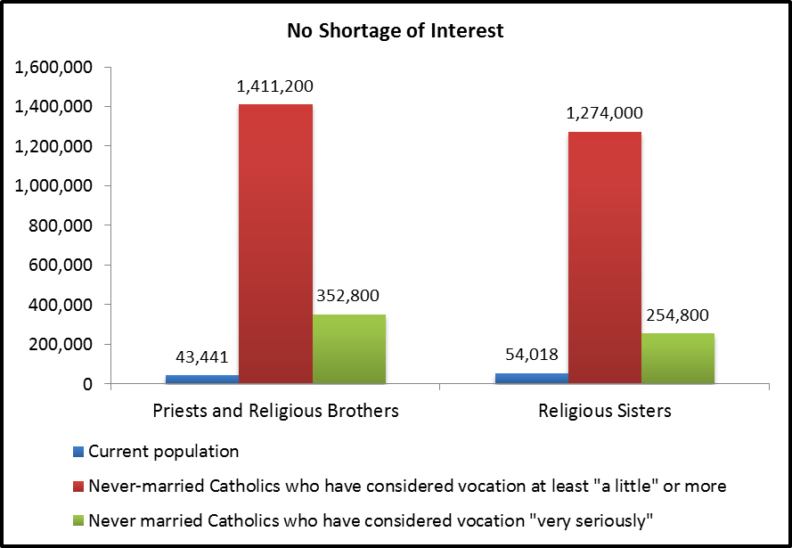

Slide 16
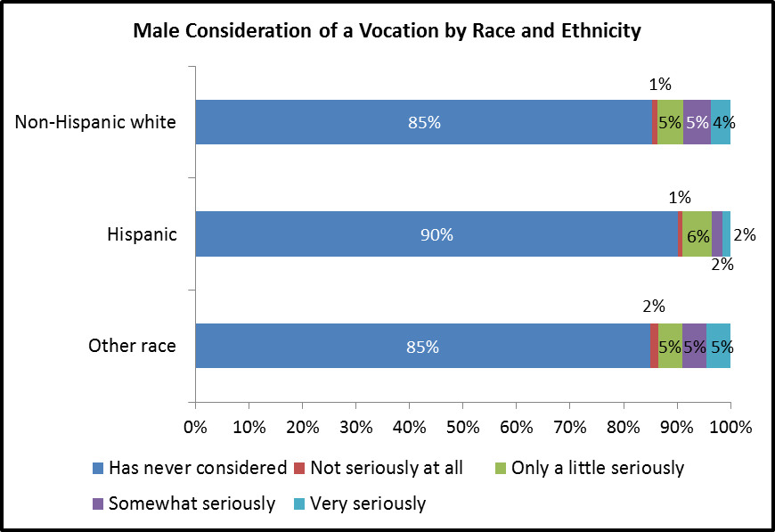

Slide 17
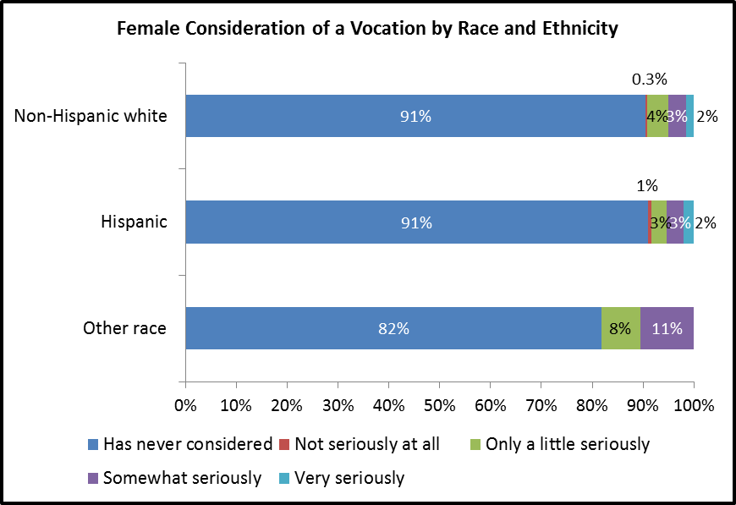

Slide 18
Key subgroups most likely to have considered a vocation
Most important:
Those who attended Catholic educational institutions at any level
Those who were encouraged to consider a vocation by any type of person
Those who personally know priests and men and women religious
Those involved in parish youth and young adult groups

Slide 19
Subgroup: Catholic Education
Minority student enrollment in Catholic schools has been hit hard by the recession. In 2005-06 NCEA reported that 27% of students in U.S. Catholic schools were something other than Non-Hispanic white. This dropped to 19% in the 2011-12 school year (currently 14% of students are Hispanic).

Slide 20
Subgroup: Encouragement (male)

Slide 21
Subgroup: encouragement (female)

Slide 22
Other Key subgroups
Also Important:
Weekly Mass attenders (now and in high school)
Those who lived in households where parents talked to them about religion at least once a week
Participants in prayer and devotional activities, groups, or programs (e.g., Bible study, Eucharistic adoration, retreats, and prayer groups)
Those belonging to a group that encourages devotion to Mary
Those who regularly read the Bible or pray with Scripture
Participants in World Youth Day or a National Catholic Youth Conference

Slide 23
Hispanic Cultural Opportunities
Institutionally they are less connected to the Church
However, Latinos have some unique cultural supports for religious participation.
  While Hispanics are no different than others in regular Mass attendance, they are much more likely to participate in prayer and devotional practices in the home, and to attend Marian feast day Masses.
  Spiritual talk at home rates higher among Latina respondents, particularly during high school.
  Higher participation rates in World Youth Day, and higher participation in NCYC for Hispanic adults.

Slide 24
A KEY CHALLENGE: Level of Education

Slide 25


United States conference of catholic bishops
Secretariat of
Clergy, Consecrated Life and Vocations
USCCB.org/Vocations email: cclv@usccb.org
Center for applied research in the apostolate cara.georgetown.edu email: cara@georgetown.edu
For further information

Slide 26
Handbook on
Seminary Admissions
Consultation held at the USCCB in June 2011
  15 psychologists, seminary & diocesan officials, canon & civil lawyers
Table of Contents
  Chapter 1: Introduction
  Chapter 2: Use of Psychology in Admissions
  Chapter 3: The Process of Admissions
  Chapter 4: Record Retention & Other Legal Concerns
  Glossary: Definition of Terms

Slide 27
Handbook on
Seminary Admissions
First chapter on the use of psychology in the admissions process under review
Chapters on the process for admissions, canonical and legal concerns, and glossary of terms still to come.

Slide 28
Program of Priestly Formation
Program of Priestly Formation, 5th edition, expires December 2015
Consultation has begun with key constituencies
    NCDVD
    NACS
    MATS
    FSSD
    Rectors
Preliminary review of the PPF as an organization
  Request for MATS to review the current PPF
  Identify norms that need improvement
  Fall 2013, work on new language
  Fall 2014, CCLV Committee considers proposals

Slide 29
CCLV Report 2012
  www.usccb.org/priestlyformation

