Slide 1
1. Open the following link:
https://www.usccb.org/committees/church-latin-america/aplicaciones-de-ayuda

Slide 2
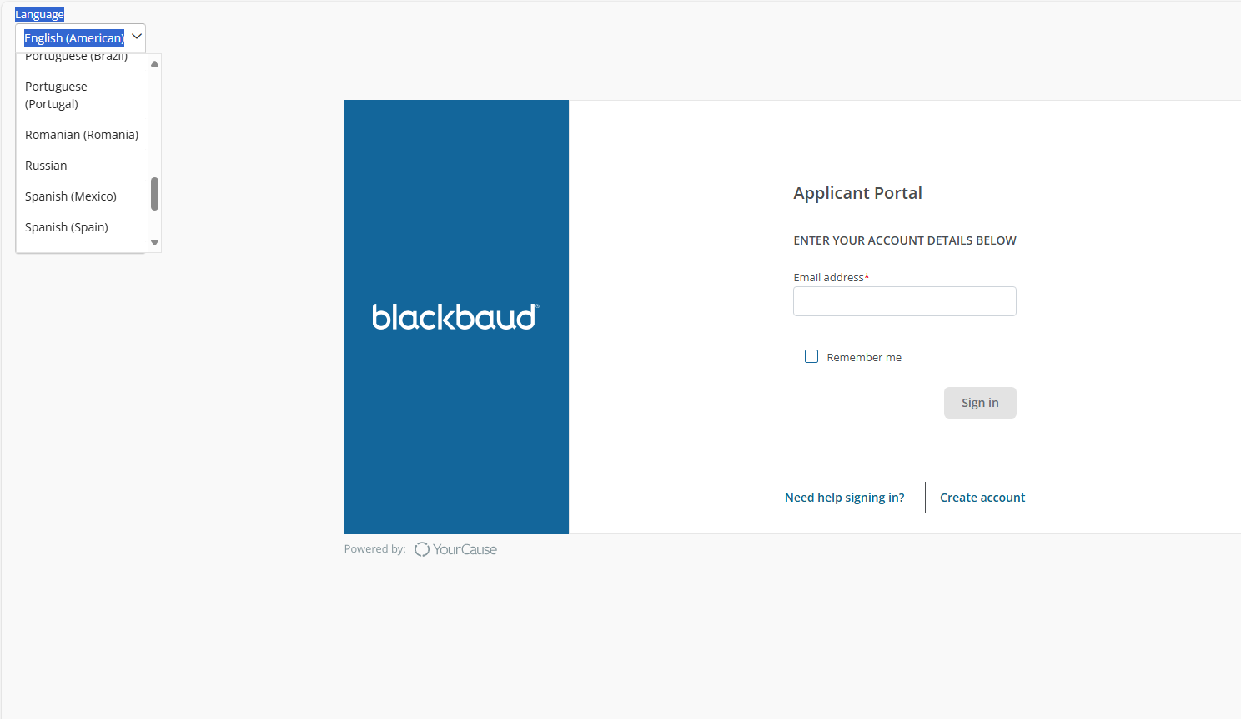
2. Due to the migration of the portal for applications, everyone will need to create a new account when applying for the first time on the new portal. Click on the 'Create Account' button at the bottom right

Slide 3
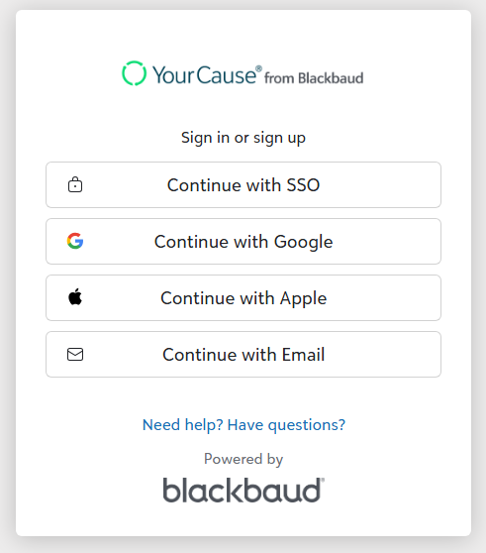
3. This will take you to the next page. Click on 'Continue with Email' and enter your email address.

Slide 4
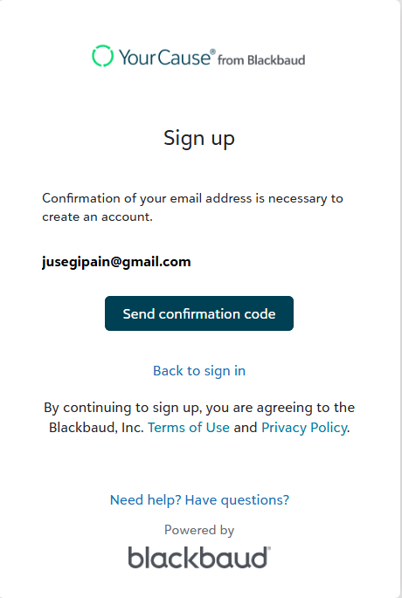
4. After entering your email, this webpage will appear. Click on 'Send confirmation code.

Slide 5
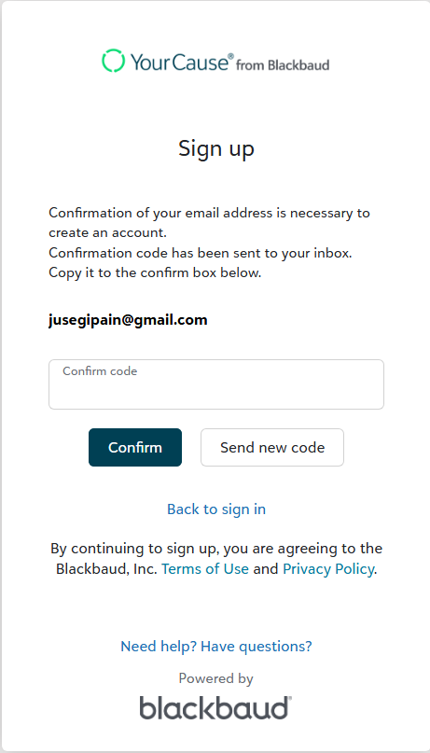
5. You will receive an email at the address you entered in step 4. Copy this number and enter it into the 'Confirm Code' field, then click the 'Confirm' button.

Slide 6
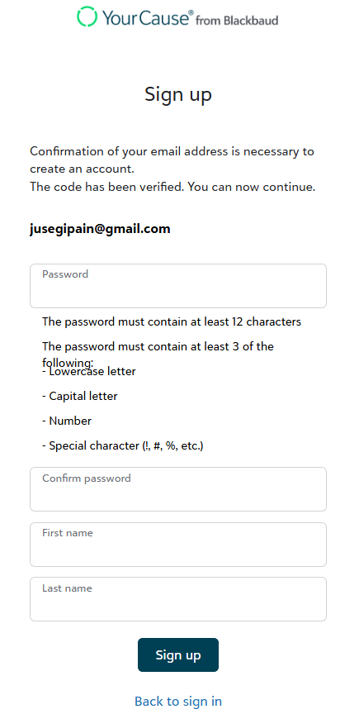
6. Enter a new password in the section labeled ‘Password’ and retype it in the ‘Confirm Password’ section. Then enter your first name in ‘First name’ and your last name in ‘Last name.’ Finally, press the ‘Sign up’ button

Slide 7
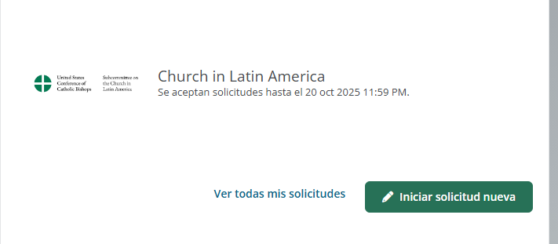
7. When you arrive at this page, click on ‘Start a new application,’ because all previous applications were deleted from the website during the portal migration.

Slide 8
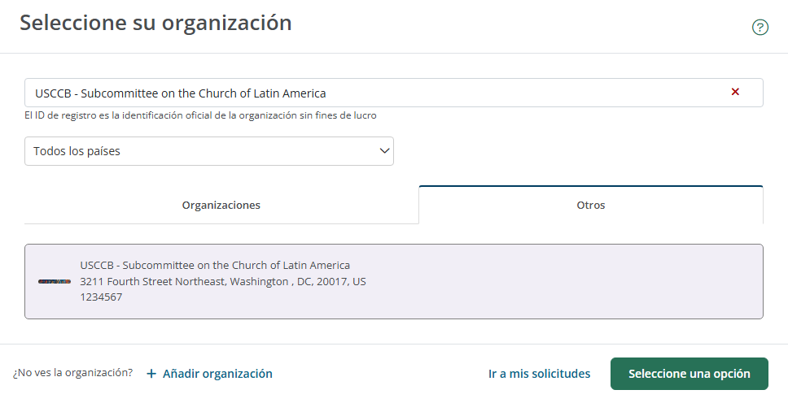
9. By clicking on ‘Start a New Application,’ the following page will open where you must enter: ‘USCCC – Subcommittee on the Church of Latin America’ and then click the ‘Other’ option. It must appear exactly as shown in the image below. After selecting this option, click the ‘Select an option’ button.

