Slide 1
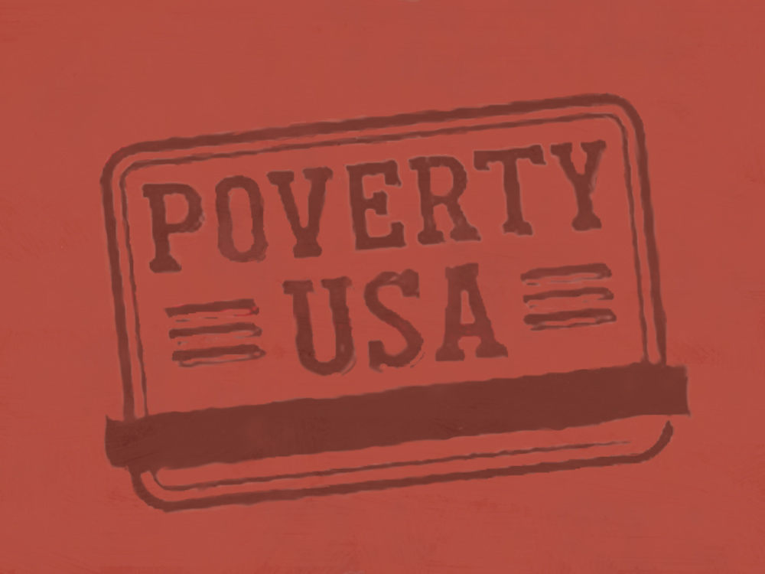

Slide 3
U | S | A
10 | 10 | 10
20 | 20 | 20
30 | 30 | 30
40 | 40 | 40
50 | 50 | 50

Slide 4
QUESTION 1-10
The number of people living in poverty in the United States decreased from 2009 to 2011.

Slide 5
ANSWER 1–10
This is FALSE. In 2011, 46.2 million people were in poverty, up from 43.6 million in 2009. Since 2007, the poverty rate has increased by 2.5 percentage points, from 12.5% to 15%.
Source: Income, Poverty, and Health Insurance Coverage in the United States: 2007 – 2011, U.S. Census Bureau

Slide 6
QUESTION 1-20
The number of families in poverty is decreasing.

Slide 7
ANSWER 1–20
This is FALSE. The number of families in poverty is increasing.
In 2011, out of 80.5 million U.S. families, 9.4 million lived in poverty. The poverty rate for people in families has risen to 13.1 percent, up from 12.5 percent in 2009.
Source: People and Families in Poverty by Selected Characteristics: 2010 and 2011,
U.S. Census Bureau.

Slide 8
QUESTION 1-30
Since its inception in 1946, the National School Lunch Program has served over 200 billion lunches to school children in need.

Slide 9
ANSWER 1–30
This is TRUE. In 2011 alone, more than 31.8 million children each day got their lunch through the National School Lunch Program.
The National School Lunch Program is a federally assisted meal program operating in over 100,000 schools and child care institutions. Children from families with incomes between 130-185% of the poverty line are eligible for reduced-price meals, for which they are charged no more than 40¢.
Source: USDA Food and Nutrition Service.

Slide 10
QUESTION 1-40
According to the U.S. Government, a family of four—two adults and two children—is living in poverty if it earns less than $35,000 annually.

Slide 11
ANSWER 1–40
This is FALSE. The federal “poverty threshold” in 2010 for a family of four with two children 18 or younger is $22,811.
However, basic needs researchers estimate that it takes an income of about 1.5 to 3.5 times the official poverty level, depending on locality, to cover the cost of a family's minimum day-to-day needs.
Source: Poverty Thresholds by Size of Family and Number of Children: 2011, U.S. Census Bureau.

Slide 12
QUESTION 1-50
Most people who are living in poverty are African American.

Slide 13
ANSWER 1–50
This is FALSE. 19.2 million non-Hispanic white Americans lived below the poverty line in 2011.
In the same year, 13.2 million Hispanics (of any race), 10.9 million African Americans, and 2 million Asian Americans were in poverty. However, as a percentage of the population, 27.6% of African Americans lived below the poverty line in 2011—the largest percentage of any group, up from 25.8% in 2009. 25.3% of Hispanics, 12.3% of Asian Americans, and 9.8% of non-Hispanic white Americans were living in poverty.
Source: People and Families in Poverty by Selected Characteristics: 2009, 2010 and 2011,
U.S. Census Bureau.

Slide 14
QUESTION 2-10
The federal minimum wage is $6.85 per hour.

Slide 15
ANSWER 2–10
This is FALSE. The federal minimum wage became $7.25 per hour July 24, 2009.
A single parent with one child working at this minimum wage full-time every week of the year ($7.25 x 40 hours x 52 weeks) would earn $15,080 before any deductions or taxes—that’s $745 below the poverty threshold of $15,825.
Source: Poverty thresholds by Size of Family and Number of Children: 2012, U.S. Census Bureau.

Slide 16
QUESTION 2-20
The poverty rate among the elderly in the United States is higher than that of any other age group.

Slide 17
ANSWER 2–20
This is FALSE. The poverty rate for elderly people in the U.S. (people 65 and older) has gone from 8.9% in 2009 to 8.7% in 2011.
However, the Census Bureau’s Supplemental Poverty Measure (SPM), which accounts for expenses such as the rising costs of health care, raises the senior poverty rate to 15.1%–higher than the overall poverty rate. Furthermore, the SPM data calculates that without Housing Subsidies the poverty rate of people 65 and over would be 16.3%, and without Social Security, 54.1% of seniors would be below the poverty line.
Source: People and Families in Poverty by Selected Characteristics: 2010 and 2011, U.S. Census Bureau,
and the Supplemental Poverty Measure: 2011, U.S. Census Bureau.

Slide 18
QUESTION 2-30
If every person in the United States that is living in poverty resided in the same state, it would be the most populous state in the nation
– the state of Poverty, USA.

Slide 19
ANSWER 2–30
This is TRUE. The current population of Poverty USA is larger than the populations of Texas, New Mexico, Oklahoma, Kansas, Nebraska, Colorado, Utah, and Wyoming… combined.
Source: Annual Estimates of the Population for the US by States and Region: 2012, U.S. Census Bureau.

Slide 20
QUESTION 2-40
One of every five children in the U.S. lives in poverty.

Slide 21
ANSWER 2–40
This is TRUE. In the year 2011, 16.1 million, or 1 out of 5, children lived in poverty. Children in the U.S. have higher poverty rates than in many industrialized nations.
In 2011, children represented 34.9% of the people in poverty in the U.S., but only 23.9% of the population.
Source: Income, Poverty, and Health Insurance Coverage in the United States: 2011,
U.S. Census Bureau.

Slide 22
QUESTION 2-50
The number of families who have regular work but remain poor—the working poor—is increasing.

Slide 23
ANSWER 2–50
This is TRUE. Since 2007 the number of working poor families has risen by 1.3 million and now 8.3% of working families remain below the poverty line despite working.
Source: Profile of the Working Poor: 2011, U.S. Bureau of Labor Statistics.

Slide 24
QUESTION 3-10
Although not below the poverty line year-round, more than ¼ of people in the U.S. spend at least 2 months living in poverty over a 2 year period.

Slide 25
ANSWER 3–10
This is TRUE. For example, during the 2-year period from 2009 through 2010, 28% of all people in the U.S. lived in poverty at least 2 months.
Source: Dynamics of Economic Wellbeing. Income, Poverty, and Health Insurance Coverage in
the United States: 2010, U.S. Census Bureau.

Slide 26
QUESTION 3-20
While the number of people in poverty has increased, the number of people in extreme poverty has decreased.

Slide 27
ANSWER 3–20
This is FALSE. The number of people living in extreme poverty - those with incomes below half the poverty line – was 19 million in 2009, but 20.4 million in 2011.
Source: Income, Poverty, and Health Insurance Coverage in the United States: 2010 and 2011,
U.S. Census Bureau.

Slide 28
QUESTION 3-30
Children of single mothers are more likely to experience poverty than the children of married-couple families.

Slide 29
ANSWER 3–30
This is TRUE. Furthermore, children under 6 are particularly vulnerable to poverty.
Children under 6 living in families with a single female head of household live in poverty at the rate of 57.2%, compared to 12.1% of those under 6 living in poverty in married-couple families.
Source: Income, Poverty, and Health Insurance Coverage in the United States: 2011,
U.S. Census Bureau.

Slide 30
QUESTION 3-40
One quarter of those with annual incomes of less than $25,000 had no health insurance in 2011.

Slide 31
ANSWER 3–40
This is TRUE. 25.4% of people with annual incomes less than $25,000 were uninsured in 2011, compared to 7.8% of people with annual incomes of $75,000 or more. A total of 48.6 million people were uninsured in 2011.
Source: Income, Poverty, and Health Insurance Coverage in the United States: 2011,
U.S. Census Bureau.

Slide 32
QUESTION 3-50
As followers of Christ and members of the universal Church, we are all called to address poverty.

Slide 33
ANSWER 3–50
TRUE!
Copyright © 2013, United States Conference of Catholic Bishops. All rights reserved. This text may be reproduced in whole or in part without alteration for nonprofit educational use, provided such reprints are not sold and include this notice.

